Slide 1
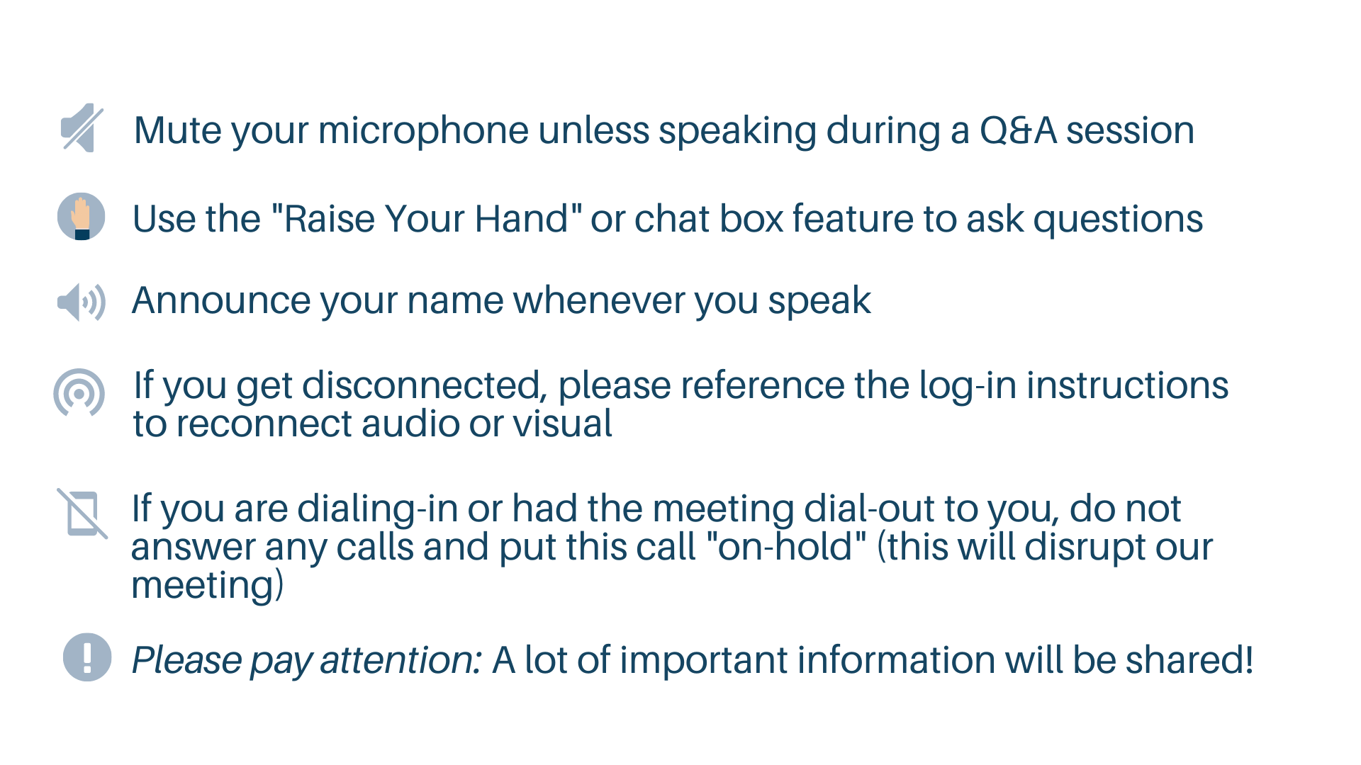
Welcome

Slide 2


Introduction to Speakers
Davonna Moore
Kansas City, MO
(Go Chiefs)
Dr. Randy Butler
Omaha, NE

Slide 3
Truck Parking Implementation
Lunch and Learn
August 13, 2020

Slide 4
Polling Question
How much longer does it take Semi-Trucks to stop than cars?
Notes:
According to FMSCA…state question
30%
25%
40%
15%

Slide 5
Purpose

Slide 6

Jason’s Law
MAP 21 Legislation
Establish Metrics
National Coalition of Truck Parking
Truck Parking Funding Opportunities

Slide 7
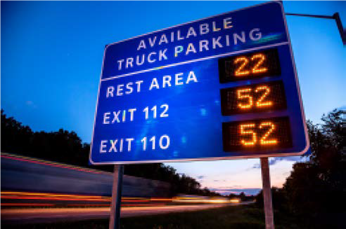
Answering the Call
MAASTO TPIMS
1-10 TPAS System
I-95 Coalition
Florida DOT
Notes:
Discuss Examples

Slide 8
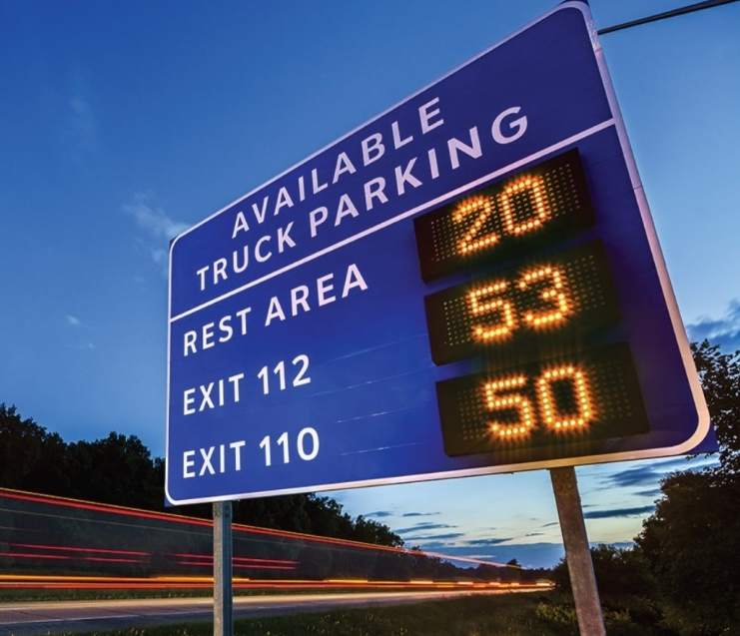
How does it help?
Real Time information
Locate signs at key routing decision points
Mobile accessible data
Provide drivers with multiple parking options
Notes:
TPIMS will provide real-time information about available parking to drivers through a variety of means.
Signs at travel decision points are one of the most important tools they want.
Truck drivers want to get information about parking availability when they can still react and make routing changes. And they also want confirmation as they approach exits that parking is still open there.
That’s why drivers rank dynamic messaging signs as one of the most favored communication methods for reaching them. There are other forms we’ll discuss later.
TPIMS also provides them with the kind of seamless system they want. Truckers told us loud and clear in the early stages of this project that they wanted the system to look and operate the same regardless of what state they were in.

Slide 9
Truck Parking Implementation

Slide 10
Policy
Desired Impacts
Implementable Strategies
Stakeholder Engagement
Define Roles and Responsibilities

Slide 11
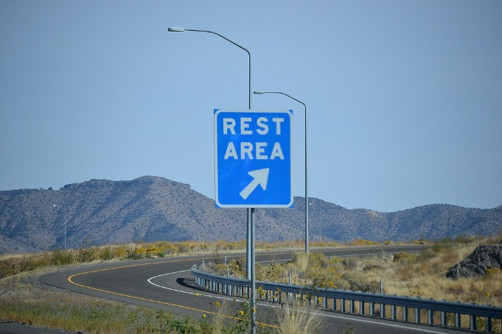
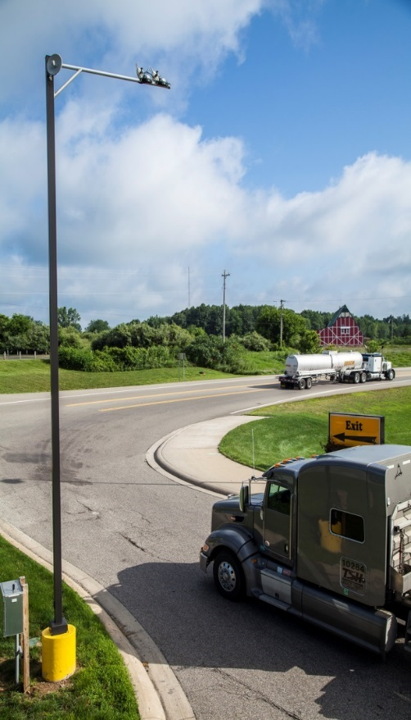
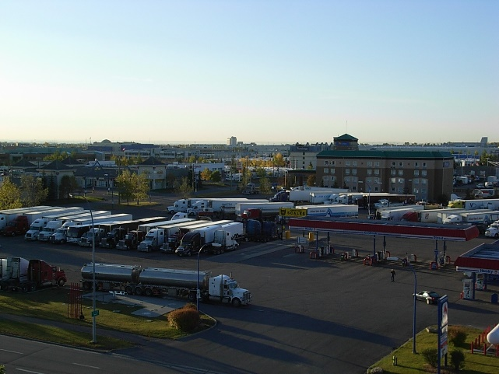
Where to Deploy
Public sites
Direct access
Limited parking slots & amenities
Greater control over data collection and distribution
Private Sites
Majority of TP system
Indirect access
Cost to drivers
Greater amenity options
Accessible Design
Notes:
One of the first questions each state has had to ask itself is whether or not it was going to include private sites.
If you confine yourself to public sites only, there are some immediate advantages. Public sites have limited parking for trucks typically. This lends itself to more straightforward system concepts, operations and monitoring. It also provides greater control to the states regarding how information can be collected and displayed. Most of the states are focused only on public sites.
Private lots, on the other hand, typically have varying and complex geometries. These do not lend themselves to more straightforward design concepts, operations and monitoring. And coordinating with the private sector can add decision-making complexities.
However, most available parking spaces are in private lots. And partnering with the private sector also offers opportunities to:
Free up grant budget for expanded site deployment;
Eliminate ongoing O & M costs;
Shift all costs for periodic technology upgrades and evolving user needs to third party vendors; and
Ease expansion to other states in the future.
Four states in MAASTO initiative (KY, IA, OH and MI) are doing private site deployments.

Slide 12
Technology
Data Collection
Data Dissemination
Implement Technologies
Notes:
Software Integration
Construction
System testing
Vendor/Developer Outreach
Performance measure data collection and analysis

Slide 13
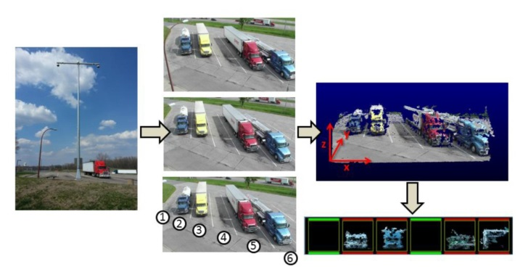
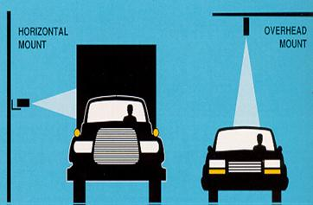
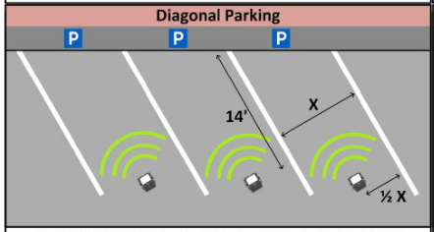
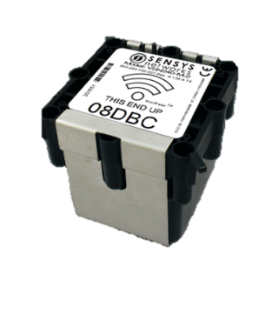
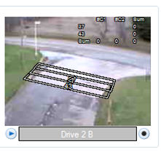
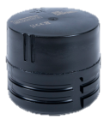
Technology Selection
Entrance and Exit Counts
Space Occupancy Counts
Infrared/magnetometers
Microwave/magnetometers
Video cameras
In-pavement magnetometer
Video cameras
Laser technology
Radar
Notes:
The next key decision relates to how you’re going to collect parking data.
There are many different systems out there for counting open parking slots.
But generally speaking, every system uses one of two methodologies:
Entrance and exit counts or
Space occupancy counts
Each has advantages or drawbacks based on the specific technology used to implement it. Ultimately, each state had to weigh how those based on their own DOT’s preferences.

Slide 14
Infrastructure
Facility Assessment
Corridor Assessment
Land Use Coordination
Project Development
Project Implementation
Utilization
Amenities
Freight Data
Segmentation
NIMBY’s
Permitting
Integration
Funding
Operations
Programming

Slide 15
Define Options
Notes:
The Federal MUTCD team provided input and guidelines for the development of the TPIMS dynamic message signs. The goal is to use consistent signage in each state to make it easy for end users (truck drivers) to locate available parking. MUTCD plans to incorporate these new sign guidelines into the next updates of the MUTCD guidance for use as other states implement truck parking information systems.
Based on truck stakeholder input, the preferred location to begin receiving parking availability information is between 30 minutes to one hour in advance of parking location. As a result, the MAATSO Partnership determined that dynamic truck parking signs would be located:
Sign Placement
• First Availability – 30 to 60 miles
• Final Availability – 5 miles
• Signs can provide availability for up to three upstream sites

Slide 16
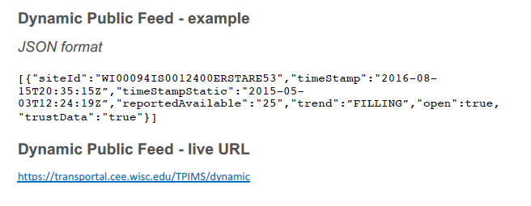

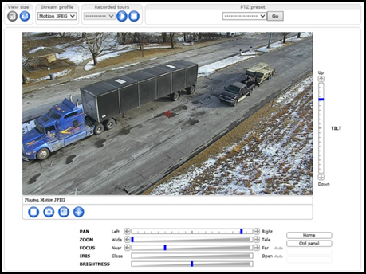
Implementation
  Software Integration
  Construction
  System testing
  Vendor/Developer Outreach
  Performance measure data collection and analysis
Notes:
Phase two is now underway. As we move towards procurement, each state is designing its individual portion of the system.
Some states are using design-build to accelerate completion. One of them, Ohio, already is in procurement and will soon be followed by Iowa and Michigan.
And we’ve put in place the measurement and reporting systems that will help us document the impact of TPIMS on the regional and national freight system.

Slide 17
Polling Question
What is the maximum amount of hours a truck driver can expend before their required stop for the day?
Notes:
11 hours
10 hours
14 hours
8 hours

Slide 18

Key Takeaways
Agency Coordination
DOTs
MPOs
Local Government
Agency Coordination needed to define and deploy technology
Notes:
Agency coordination to Define and Deploy Technology

Slide 19

Questions and Answers
Please type your questions in the questions box and our project team will answer them
If we do not get to all the questions, we’ll prepare written responses and post them to the website with the meeting recording

Slide 20
Smart Freight
Technology
Palmetto Freight Series

Slide 21
Smart Freight Technology
Automated Driving Systems
Truck Platooning
Freight Advanced Traveler Information + Smart Parking (FRATIS+P)
Smart Mobility – DrayFLEX Trip

Slide 22
Smart Freight Technology Goals
Improve freight travel times and traffic flow along freight-intensive city streets and interstates.
Enable improved logistics efficiencies by maximizing loaded moves for participating logistics companies.
Enable two-truck platoons for logistics companies to reduce fuel consumption and emissions.

Slide 23
Automated Driving Systems

Slide 24
ADS Program Goals
Safety: Test the safe integration of ADS into the Nation’s on-road transportation system
Data for Safety Analysis and Rulemaking: Ensure significant data gathering and sharing of project data with U.S. DOT and the public throughout the project in near real time, either by streaming or periodic batch updates, and demonstrate significant commitment to leveraging the demonstration data and results in innovative ways
Collaboration: Create collaborative environments that harness the collective expertise, ingenuity, and knowledge of multiple stakeholders

Slide 25
Truck Automation ADS Grant Goals
Enhanced road safety through development and deployment of Automated Driver Assistance (ADA) Systems.
Data gathering using real systems on public roads in real-world driving situations.
Eco-system development and collaboration.
Enabler of higher levels of automation and safety systems.

Slide 26
Truck Platooning

Slide 27
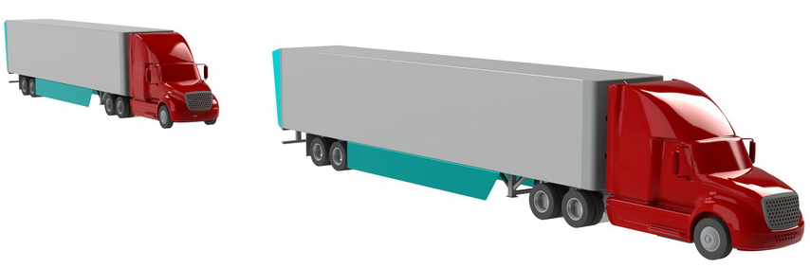

Truck Platooning Concept
As vehicles approach, they influence the flow-field around each other
Low-speed air-wake of lead vehicle influences trailing vehicle
(lower airspeed = lower drag)
High-pressure zone in front of trailing vehicle influences lead vehicle
(pushes on the front vehicle)
Trailing Vehicle
Separation
Distance
Distance between trucks can vary
between 4 to 87 meters
Lead Vehicle
27

Slide 28
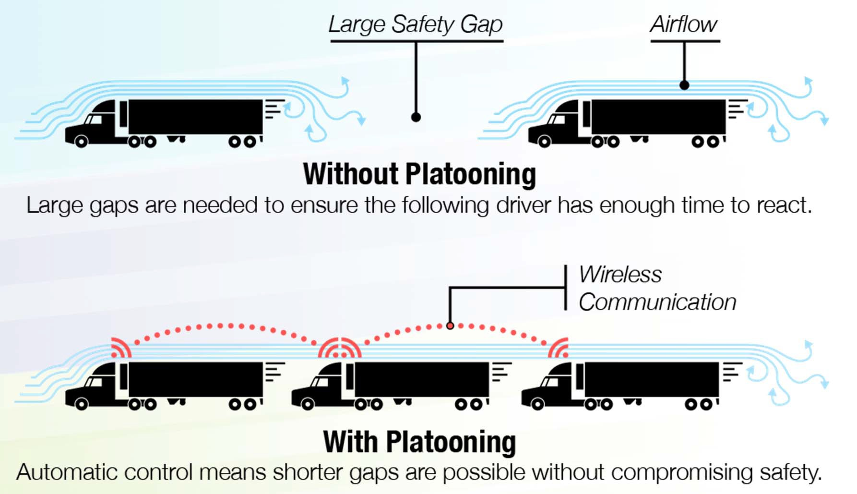
Truck Platooning Potential Benefits
Potential benefits:
Reduces fuel
consumption and emissions​
Improves traffic flow​
Reduces highway congestion

Slide 29
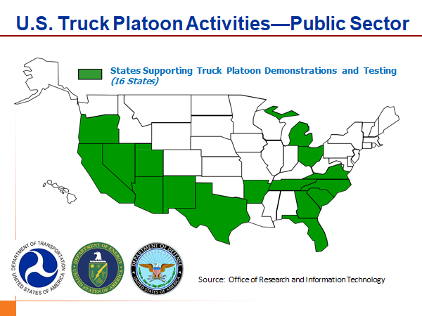

Slide 30
Public Sector Testing Considerations
Legislation
Law Enforcement Training
Vehicle Markings
Public Awareness
Operational Domain
Notes:
Some states have FTC laws that might preclude platooning; interstate commerce requires uniformity or special exceptions. We will be seeking an exemption to Ohio’s FTC law.
Law enforcement training is needed so officers are aware of the test. This includes weigh station operations.
Will trucks have strobes or beacons to indicate platooning in progress? There needs to be consensus between states on what is required.
How should you publicize the test and promote public awareness? This is related to vehicle markings but also could involve a public outreach campaign.
Operational domain: In what types of weather is platooning allowed? At what times of day? What happens in a work zone? Heavy traffic? Is platooning only allowed on Interstates outside of cities, or will it be allowed in more congested areas or even city streets?
Also requires host fleet input. Our initial strategy is to only allow platooning on the Interstate portion of the trip, outside of major urban areas.

Slide 31
Freight Advanced Traveler Information + Smart Parking (FRATIS+P)

Slide 32
FRATIS Available Services
Truck Parking information Services (TPIS)
Truck Alternate Routing Services (TARS)
Truck Travel Predictive Services (TTPS)
Truck Road Weather Travel Services (TRWTS)

Slide 33
FRATIS Available Services
Truck Parking information Services (TPIS)
  Network of commercial and public facilities
  Real-Time Information on availability
  Truck Parking Reservations
  Information on availability pushed to driver
Truck Alternate Routing Services (TARS)
  Truck-specific GPS navigation solution that accounts for truck-restricted and prohibited roads
  Provide safe and reliable navigation around congestion and accidents

Slide 34
FRATIS Available Services
Truck Travel Predictive Services (TTPS)
  Predicts travel distance and arrival time and distance based on:
    Driver’s current location
    Current traffic conditions
    Historical traffic patterns
    Estimated hours of service remaining
    Considers persistent trends (seasons, holidays, and months)
    Temporal trends (construction)
    Dynamic trends (weather)
Truck Road Weather Travel Services (TRWTS)
  Pushes road weather link-specific information to drivers
  Provides road weather alerts and warnings within a short time horizon of adverse conditions

Slide 35



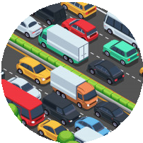





















State DOTs Real Weather
Information Systems
State DOTs Real Time
Traffic Information
Predictive Traffic and Data Analytics
Truck Parking Availability Applications
FRATIS-P
“CLOUD”
FRATIS-P User
FRATIS-P User
FRATIS-P User

Slide 36
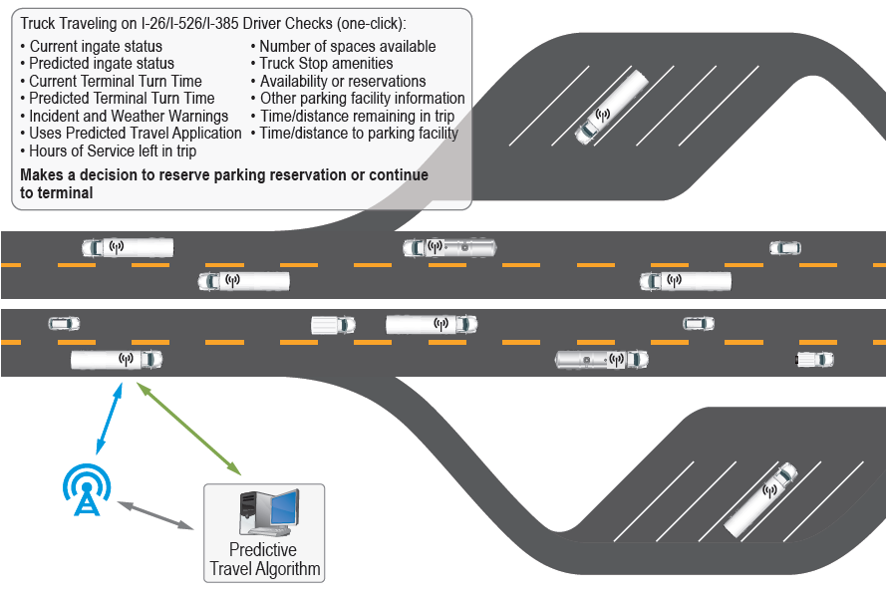
Example Truck Parking Push Notifications…….
Predictive Algorithms Provide Best Solution
Truck Driver Receives Push Notifications
I-29/I-435

Slide 37
Benefits to Freight/Logistics Companies
Improve productivity and efficiency of the fleet
Empower drivers with real-time information for faster and better decisions
Generate near optimal truck planned work itinerary taking into consideration travel times with traffic, waiting times at the terminal, weather conditions, etc.
Drivers will be able to navigate to their destinations and be rerouted in case of heavy traffic, incidents and congestion in their current route

Slide 38
Public Benefits
Improve air quality and traffic operations
Provides a platform to support economic development in the region
Improve quality of life of the region
Better utilization of existing infrastructure and capacity
Provides capabilities for safer routes for trucking operations

Slide 39
Drayage Freight and Logistics Exchange (DrayFLEX)
Southern California

Slide 40
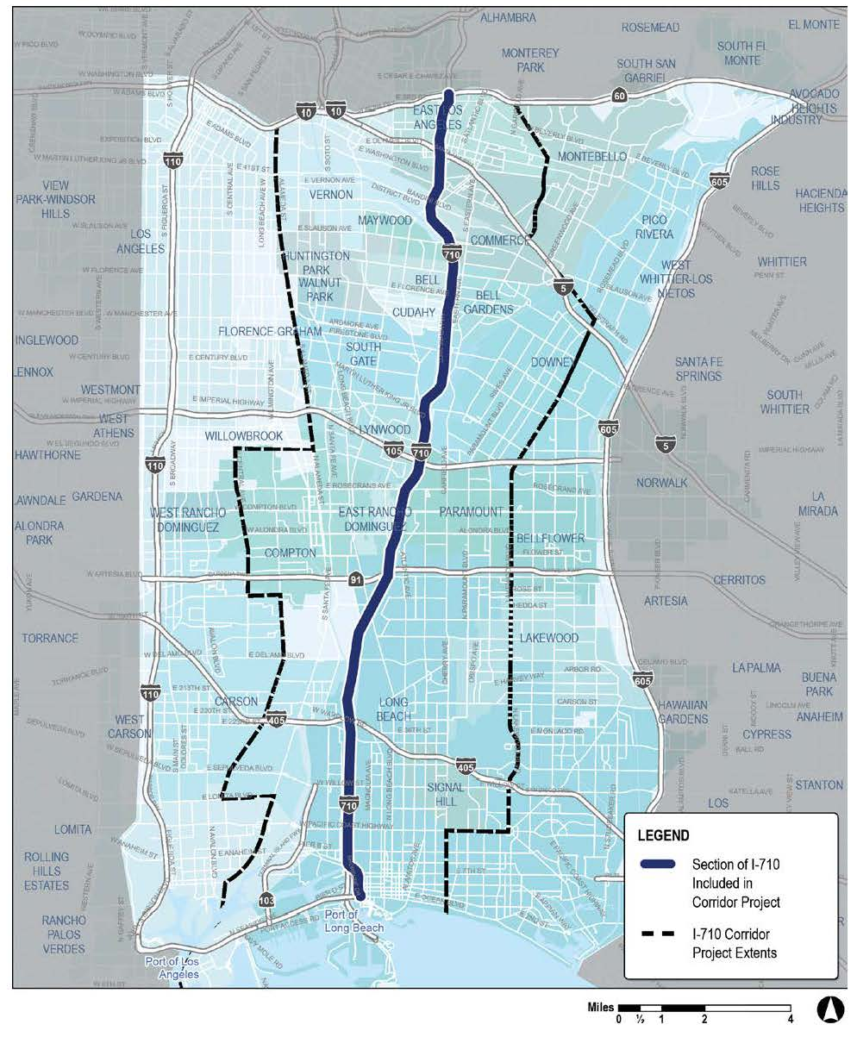
What is the DrayFLEX Program?
Overall program goals:
  Improve freight movement coordination
  Improve terminal efficiency
  Reduce delays and truck queueing
  Reduce fuel consumption and emissions
Notes:
DrayFLEX is deploying ITS technology to improve goods movement, safety, and emissions around the San Pedro Bay ports.
Those ports form the biggest port complex in North America and handle two thirds of the country’s containerized imports via 13 container terminals.
Expanding infrastructure is difficult for cost and environmental reasons.

Slide 41
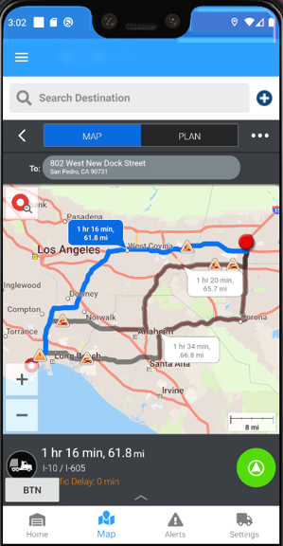
Truck Routing Example
Events and notifications
  Slow-down ahead
  Fuel-efficient routes
  Incidents
Can be integrated with regional ITS
Notes:
Routing is always truck-friendly and includes notifications like fuel efficient routes, dangerous slow-downs, and incidents.
DrayFLEX was designed so it could integrate with L.A. County’s regional ITS.

Slide 42
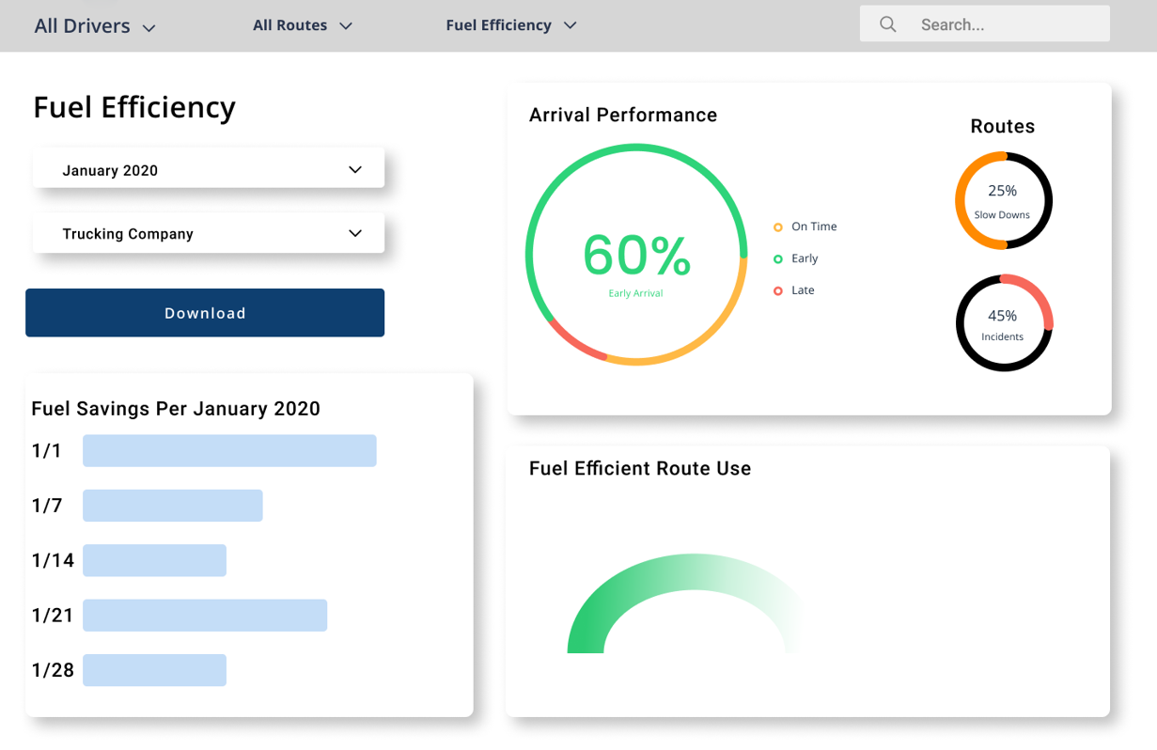
Performance Measures
Notes:
DrayFLEX also features performance dashboards to understand program impacts.
The metrics would be tailored to different user groups like agencies and truck drivers.

Slide 43
Questions and Answers
Please type your questions in the questions box and our project team will answer them
If we do not get to all the questions, we’ll prepare written responses and post them to the website with the meeting recording

Slide 44

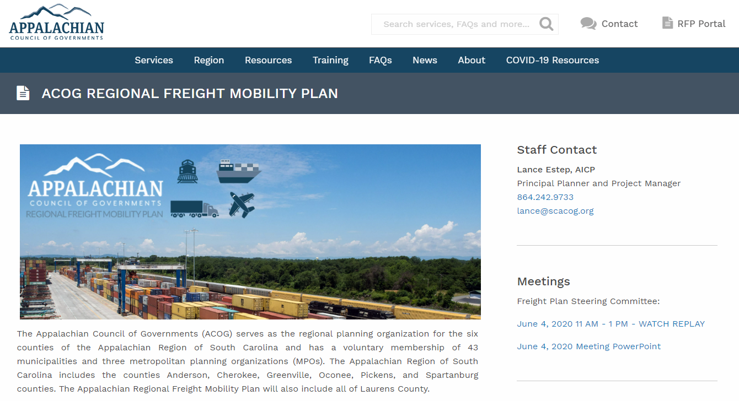
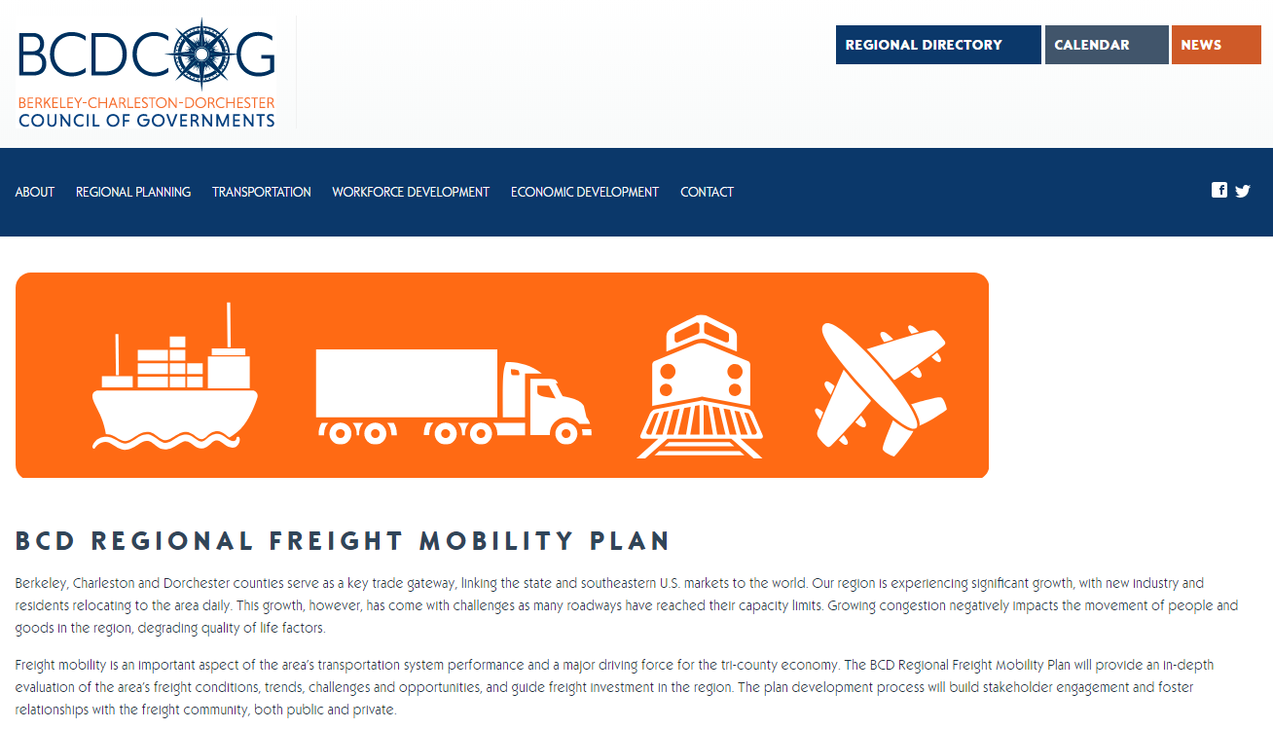


Stay Connected!
ACOG
scacog.org/acog-freight-plan
BCDCOG
bcdcog.com/freight
@AppalachianCouncilofGovernments
@BCDCoG
@SCACOG
@BCDCog

