Slide 1
Welcome

Slide 2
Appalachian Regional Freight Mobility Plan
Joint Steering Committee and Freight Advisory Committee Meeting
July 29, 2021

Slide 3
AGENDA
1
Welcome!
2
Freight Plan Work Products
3
Public Engagement Summary
Public Engagement Summary
4
Summary of Plan Recommendations
5
Implementation of the Freight Plan
Notes:
Welcome back and welcome to this JOINT meeting of the ACOG Regional Freight Mobility Plan STEERING COMMITTEE AND FREIGHT ADVISORY COMMITTEE
From your perspective, things have appeared to be fairly quiet as far as the planning process goes, but this team has been very busy! We’re so excited to reach this point in which we can roll out the “DRAFT FINAL” freight mobility plan and its many components.
This is our agenda for today’s meeting…
The GOALS of today’s meeting include:
Summarize what all we’ve got for your review
Provide a summary of the outreach efforts of this past year
Provide an overview, sort of “how to read this plan” so you can best focus your energy in this review process
Provide an overview of the key elements of the plan recommendations
Finally – give you YOUR marching orders on how, collectively, this plan gets implemented

Slide 4
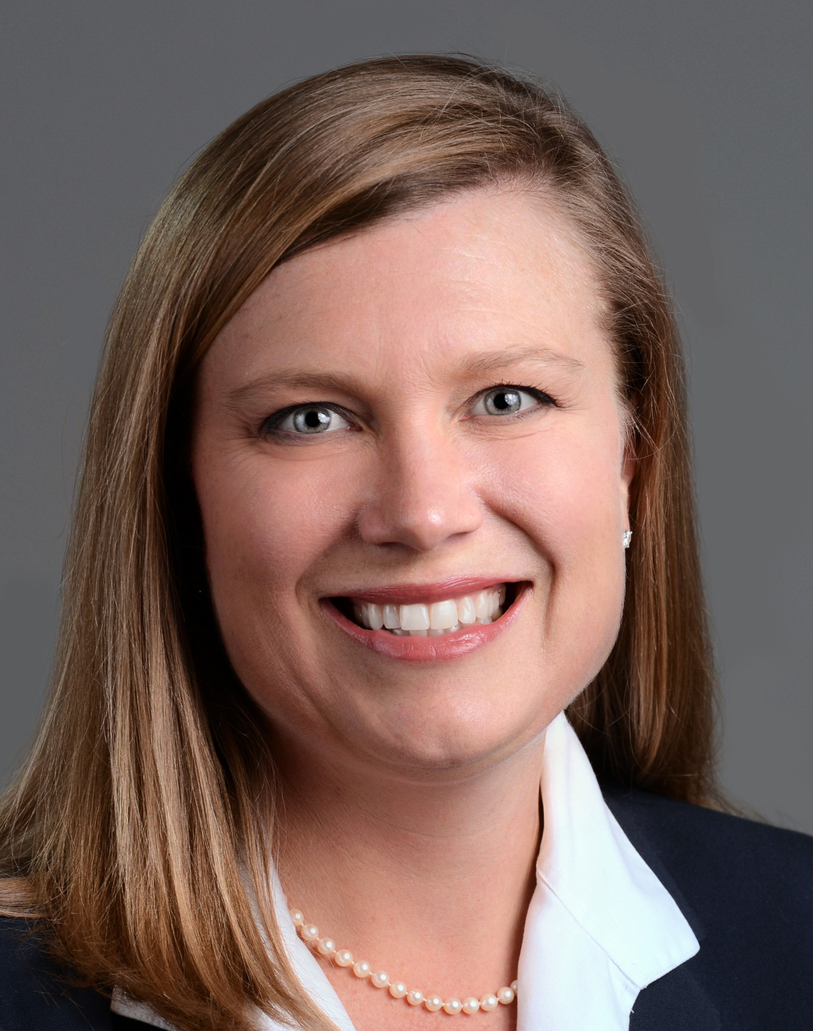
Introduction to Speakers
Lance Estep, AICP Appalachian Council of Governments
Project Manager
Greenville, SC
Jenny Humphreys, AICP CDM Smith Consulting Team
Project Manager
Charleston, SC
Notes:
AMY TO GIVE BRIEF INTRODUCTION
LANCE:
Senior Transportation Planner with App. Council of Governments
Participates in many comprehensive plans in the region – very well versed in both land use and transportation planning in the region
Will be the SINGLE POINT OF CONTACT for project related information for the Freight Advisory Committee
JENNY
Senior Transportation Planning with CDM Smith
Based in Charleston, SC
Previously managed SCDOT Statewide Freight Plan, Columbia and Charlotte Freight Mobility Plans
Leading this team of planners, economists and engineers to deliver this for the Appalachian Region!

Slide 5
Freight Plan Stakeholders
Your Role on the Project
Learn
Provide Feedback
Connect with Colleagues
to Raise Awareness
Maintain Momentum
Support the Implementation
Notes:
This slide summarizes your role as a stakeholder. We introduced this slide last year during our first meeting, and we have navigated through learning, feedback, connections, and momentum and are now heading toward the implementation phase of your involvement, which we all know is the most critical element of any plan.
Jenny walked through the agenda with you a few minutes ago. Just something to keep in mind. This is a planning document that will continue to evolve. As we discuss some of the plan recommendations with you this morning, just remember that this is only the beginning of our freight discussions. I imagine that we will be talking about specific programs, policies and infrastructure projects pertaining to freight for many years after we accept this plan, so this plan is really a snapshot of the current conditions on the ground. As we know, conditions change often in the Upstate…so we need a planning document that can stay alive and adapt to those changing conditions.
As we move through today’s agenda, please be thinking about a few things, including:
What am I interested in understanding? Which sections of the plan are most important to me?
What recommendations can I support? What role can I play in that?
What am I NOT comfortable with in this plan – and what actions do I need to take to address my concerns?

Slide 6
Summary of Final Work Products

Slide 7
Freight Plan Work Products
Freight Plan “Must Have” Components:
Agency Coordination, especially SCDOT and FHWA
Existing Freight Conditions
Economic Context
Public Engagement
Prioritized Freight Recommendations
Freight Needs Assessment
Integration with Land Use Planning
DELIVERABLES:
Regional Freight Mobility Plan
Freight Plan Appendices
Public Engagement Summary
Best Practices and Freight Technology
Freight Network Assessment
Land Use Analysis
Freight and Economics Analysis
Steering Committee Briefing Decks
Executive Summary Brochure
Freight and Economics Executive Summary Brochure
Archived Data
Notes:
When we kicked off the plan, we talked through this list of key components of a Regional Freight Mobility Plan –
On the right is the list of deliverables – and we’ll talk through where to find each of those key elements.
Big picture Goals:
“We don’t want a plan that sits on the shelf”
Main Plan Document is thick, but not overwhelming
Tech Memoranda in the form of appendices
Brochure Style Exec Summaries
Data
Let’s talk through those

Slide 8
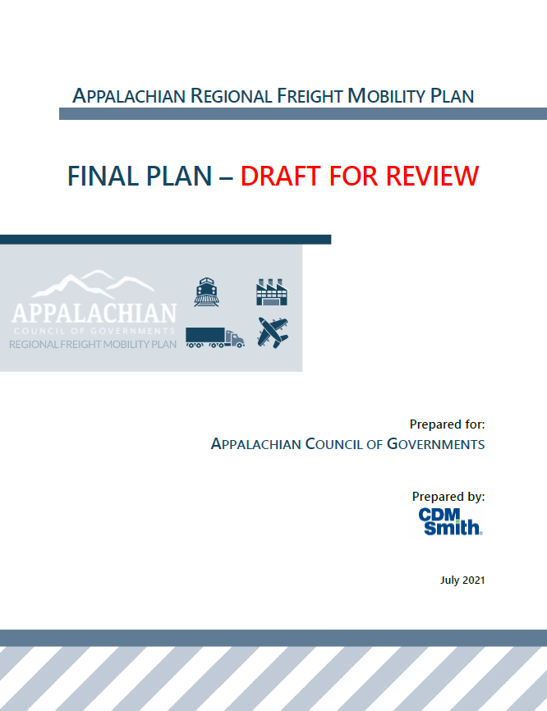
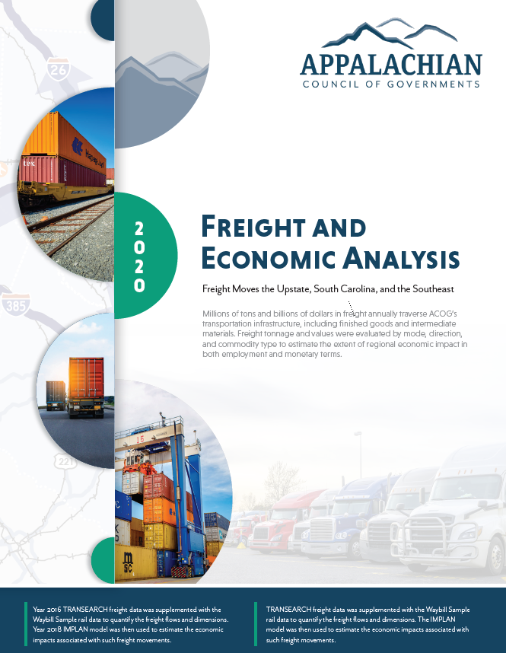
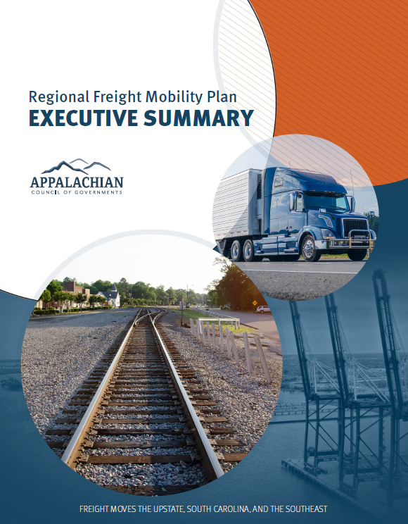
Freight Plan Work Products
Notes:
More public facing documents
Executive Summaries for high level overviews
Appendices for deeper dives into materials

Slide 9
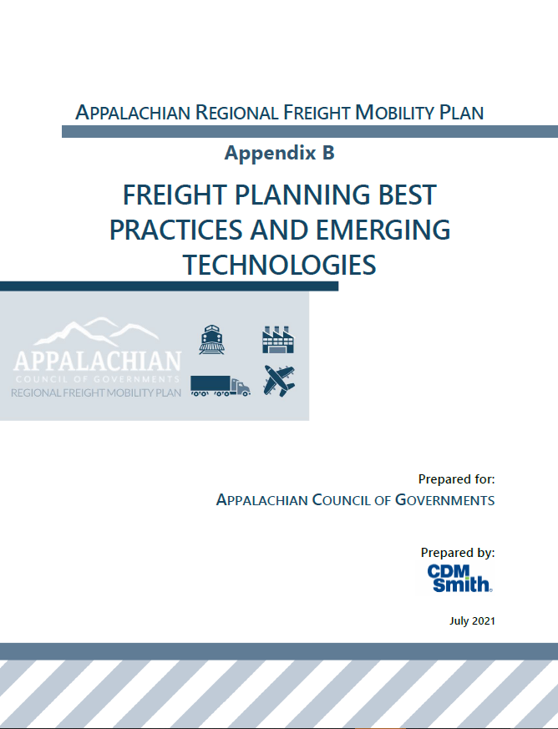
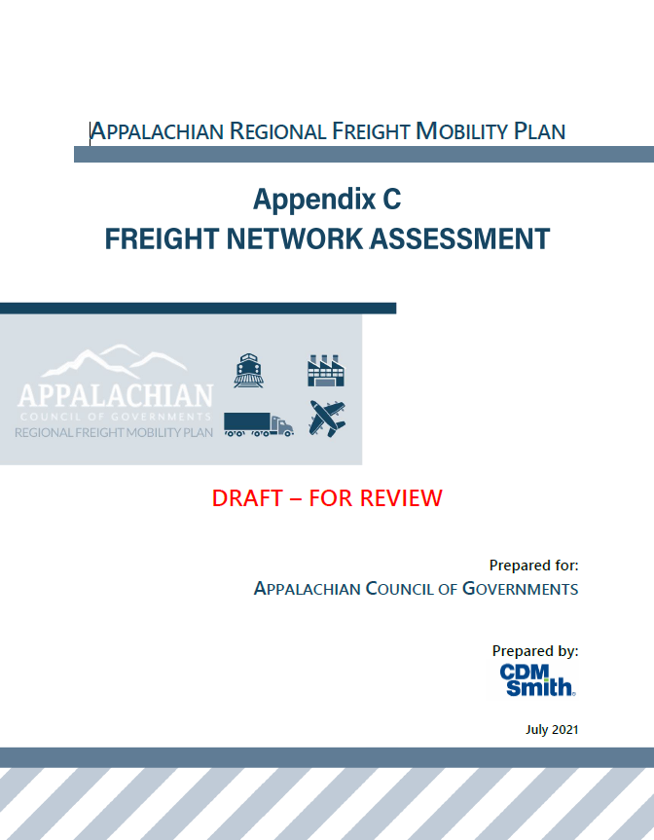
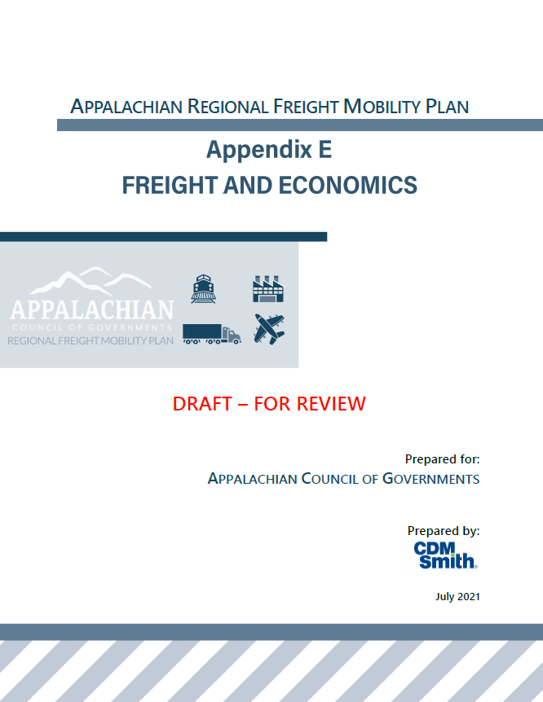
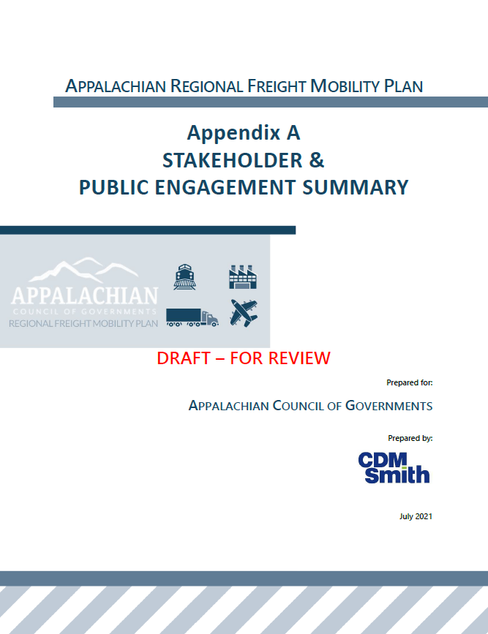
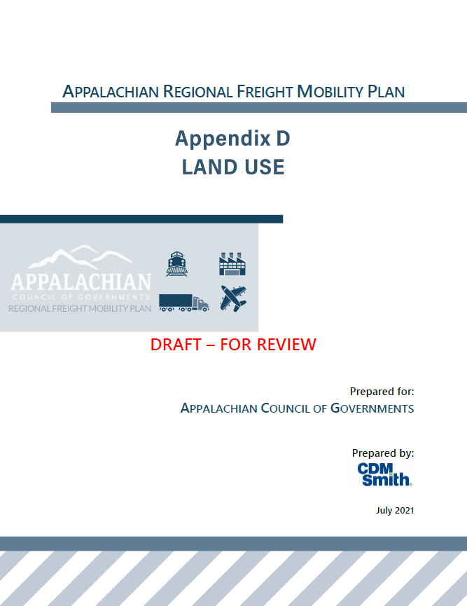
Technical Memoranda - Appendices
Notes:
Audiences include planning staff, scdot/MPO/COG/County staff
Implementation deep dives – better understanding of context

Slide 10
Briefing Decks
Notes:
These remain on the ACOG website – and provide various audiences with the background information that we discussed as a group here as a Steering Committee.
Similar to the Appendices, these provide that ‘deeper dive’ into some of the information we evaluated and presented to you all through the plan development
Meeting content remains available for use by ACOG and partners (recycling of materials related to the freight plan)

Slide 11
Meeting Content & Archived Recordings
Plan documents
Steering Committee Meeting Materials and Recordings
Freight Advisory Committee Meeting Materials and Recordings
Palmetto Freight Series Recordings
Contact Info for More Information
Notes:
The audience for this information is the general public – anyone and everyone interested in the work products, meeting recordings, powerpoint presentations – and contact info should they need more information
Should newcomers to the region be interested – info is available
Key stakeholders want to know more, or perhaps they missed a meeting and want to hear the dialogue or more thorough discussion

Slide 12
Public Engagement Process
Notes:
Quick summary of how we delivered interim information and pulled insight from the community

Slide 13
Overview of Public Engagement
Notes:
Graphic illustrates the overall approach to engage multiple audience TYPES; we’ll dig in a little more to share how this was implemented
Important to point out our Agency Coordination on this effort. A BIG THANK YOU to SCDOT and FHWA for their participation in our meetings, follow up dialogue and certainly reviews of all draft deliverables. Their buy-in is crucial due to the need for alignment in the implementation of this planning effort.

Slide 14
Meeting Series
STEERING COMMITTEE MEETING DATES (2020) | STEERING COMMITTEE MEETING TOPIC | LUNCH & LEARN WEBINAR TOPICS
June 4 | Introduction to Freight Planning | N/A
July 16 | Best Practices & Network Assessment | Smart Cities & Railroad Technology
August 13 | Land Use Analysis | Truck Parking & Automation
September 10 | Goals, Objectives, & Performance Measures | Freight Data Analysis
October 8 | Economic Impact Analysis | N/A
November 12 | Draft Recommendations: Policies and Programs | SC Ports Virtual Tour
December 10 | Draft Recommendations: Projects | N/A
Final Plan

Slide 15
COVID Protocol
Emphasized Online Engagement:
Online Steering Committee Meetings
Palmetto Freight Series Webinars
Online Surveys
Phone Interviews

Slide 16
Agency Participation

Slide 17
Roster of Steering Committee
Agency | Representative
Anderson County Economic Development, Anderson County | Burriss Nelson
Cherokee County Development Board | Jim Cook
Cherokee County Development Board | Ken Moon
Greenville Area Development Corporation | Mark Ferris
Laurens County Development Corporation | Jonathan Coleman
Oconee Economic Alliance | Annie Caggiano
Alliance Pickens | Jeromy Arnett
Spartanburg Economic Futures Group | Kyle Sox
Cherokee County | Steve Bratton
Greenville County | Kurt Walters
Laurens County | Jon Caime
Oconee County | Adam Chapman
Pickens County | Chris Brink
Spartanburg County | Billy Martin
SCDOT - Intermodal | Diane Lackey
SCDOT - Planning | Christina Lewis
SCDOT - Production | Jim Walden
FHWA Community Planning | Mark Pleasant
Agency | Representative
Ten at the Top – Upstate Mobility Alliance | Michael Hildebrand
GSP Airport | Mike Forman
SC Ports Authority | Barbara Melvin
SC Ports Authority | Steve Kemp
SC Ports Authority | Hampton Lee
City of Gaffney | James Taylor
City of Greenville | Valerie Holmes
City of Greenville | Allen Reid
City of Greer | Ashley Kaade
City of Spartanburg | Chris Story
City of Woodruff | Lee Bailey
GPATS MPO | Keith Brockington
SPATS MPO | Lisa Bollinger
ANATS MPO and City of Anderson | Mike Gay
Upper Savannah Council of Governments | Rick Green
ACOG | Lance Estep

Slide 18
Roster of Freight Advisory Committee
Agency | Representative
BMW Manufacturing | Alfred Haas
SC Ports Authority | Hampton Lee
SC Ports Authority | Mike Hoffman
Carolina Piedmont Shortline RR | Billy Tucker
C.H. Robinson | Brandon Huell
Norfolk Southern | Brian Gwin
Michelin | Leesa Owens
G & P Trucking | Clifton Parker
Maritime Association of South Carolina | Heather Holmquest
Continental Tires | Corey Mabry
SCDOT | Doug Frate
Agency | Representative
SCDOT | Diane Lackey
SCDOT | David Gray
Sunland Logistics | Elijah Ray
NAI Earle Furman | Hal Johnson
Clemson University - ICAR | Jack Ellenberg
CSX Railroad | John Dillard
U of SC - Operations and Supply Chain Center at the Darla Moore School of Business | Linda Oldham
SC Trucking Association | Rick Todd
GSP Airport | Scott Carr
SC Logistics | Taylor Jackson

Slide 19
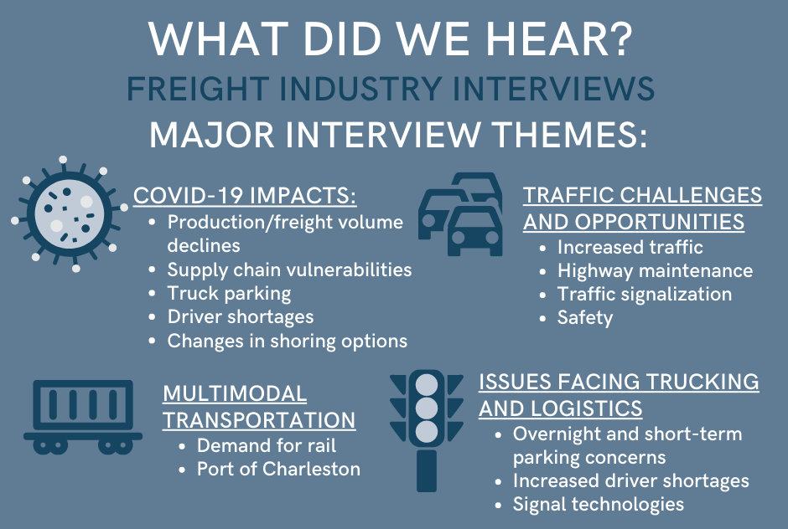
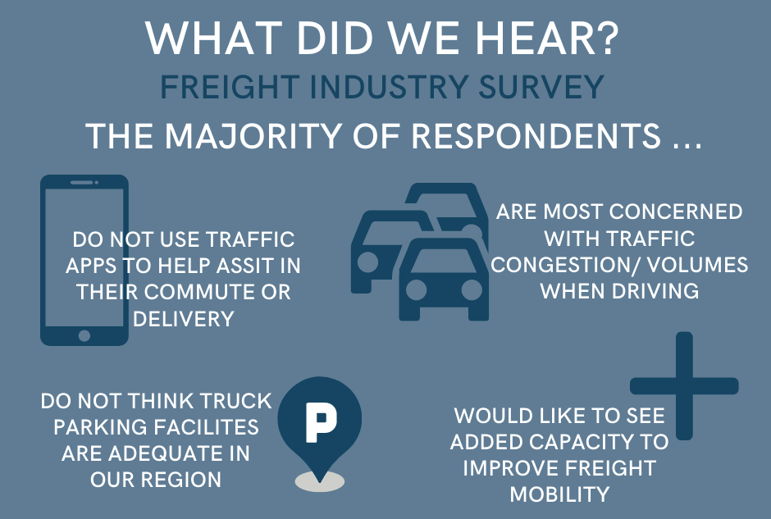
Interviews & Online Surveys
Stakeholder Interviews: Oct. – Nov. 2020
Online Survey: Oct. 6 – 25, 2020
27 Respondents
Notes:
In addition to our group setting conversations, we had a series of follow up outreach efforts.
Melissa Ziegler personally contacted a number of members of the local industry to talk through a set list of questions – somewhat sticking to a script to get some key information needed, but also allowing for the conversation to move in the direction of each individual person or company.

Slide 20
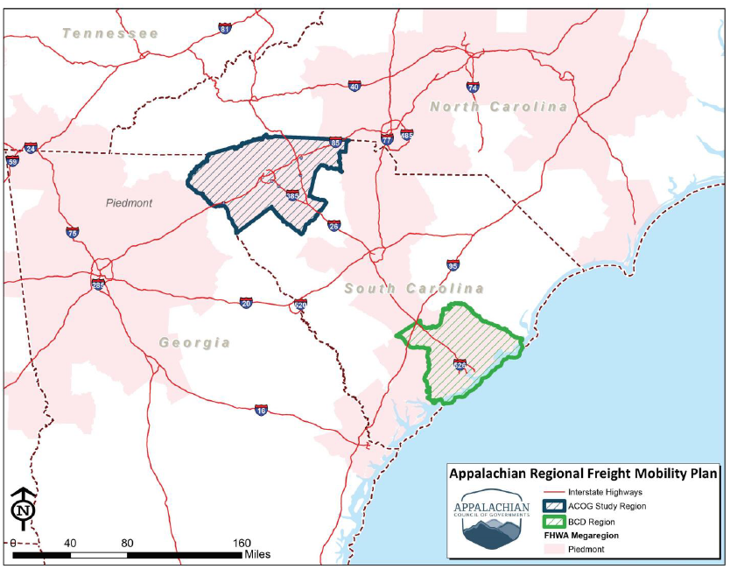
Palmetto Freight Series
STEERING COMMITTEE MEETING DATES (2020) | LUNCH & LEARN WEBINAR TOPICS
June 4 | N/A
July 16 | Smart Cities & Railroad Technology
August 13 | Truck Parking & Automation
September 10 | Freight Data Analysis
October 8 | N/A
November 12 | SC Ports Virtual Tour
December 10 | N/A
Notes:
When we kicked things off, we talked about the significance of megaregional planning and seeing beyond our local jurisdictional boundaries. This was factored into the plan development through:
Alignment of goals, objectives and performance measures with our MPOs and SCDOT
Identification of implementation partnerships within our regional boundary but also at the larger level – partnering with other COGs and MPOs in SC
Public outreach through the “Palmetto Freight Series” of webinars. We lined these up our colleagues participating in the BCD Regional Freight Mobility Plan and the topics discussed are on this slide
All materials were ‘generic’ in nature – designed to be educational and relevant to both study areas (and those in between)!
All materials are still available online

Slide 21
Summary of Plan Recommendations

Slide 22
Types of Freight Recommendations
Projects – proposed freight infrastructure improvements that meet identified freight needs and deficiencies PRIORITIZED
Policies – recommendations that provide guidance in the maintenance and investment of the freight infrastructure and movement of goods LISTED
Programs – recommendations for short term interventions to improve the regional freight mobility system LISTED

Slide 23
Project Prioritization Process
Notes:
As mentioned previously – and presented earlier in the plan development – we prepared a series of Freight Mobility Plan Goals – and prepared a set of supporting objectives and performance measures.
We’ll briefly go through these – and show you the “behind the curtains” look at the prioritization process

Slide 24
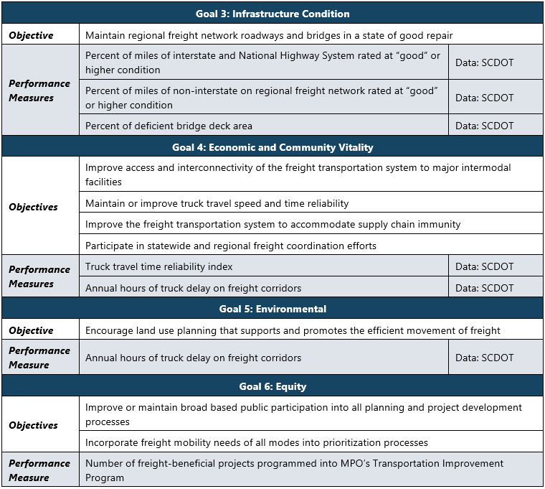
Prioritization Process

Slide 25
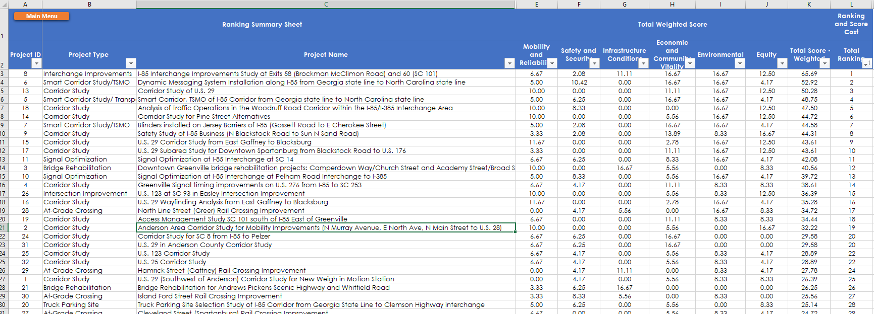
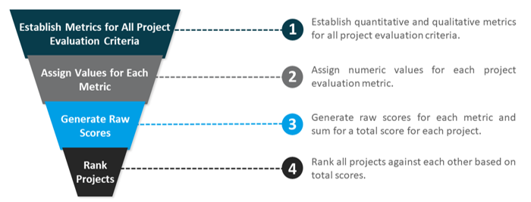
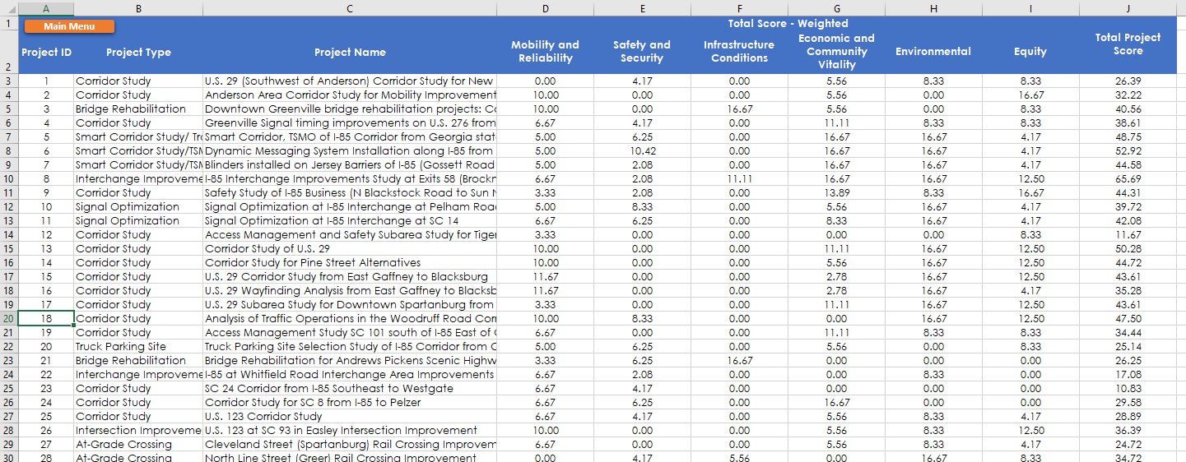
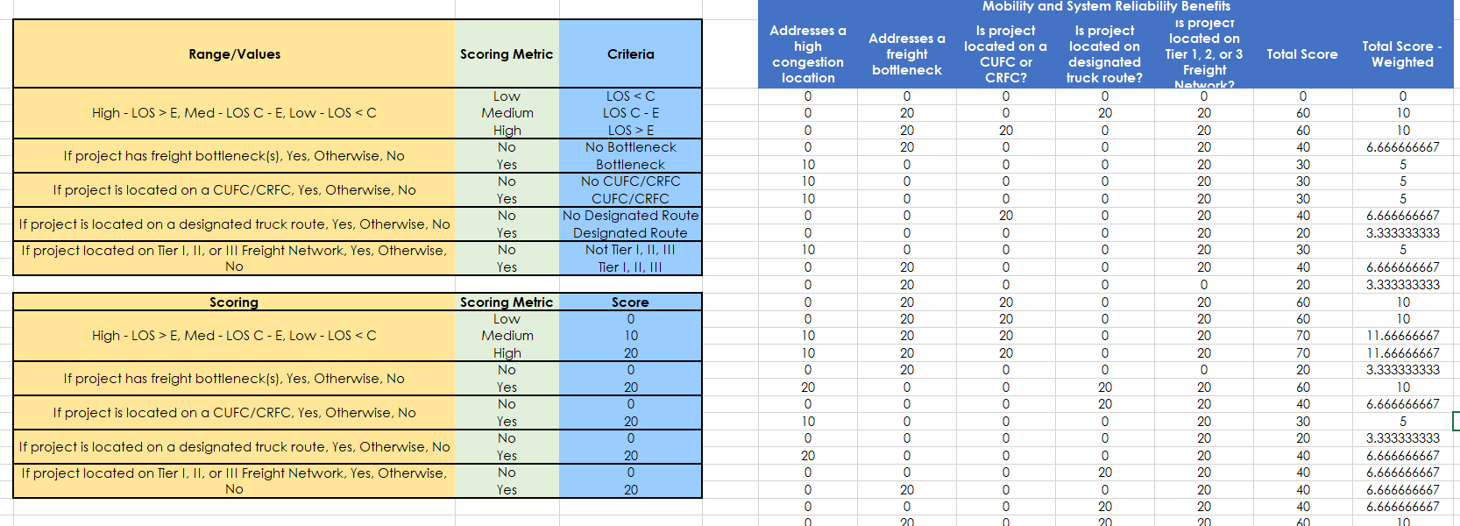
Project Prioritization Process
Notes:
Started with a list of “needs” – based on data and input from our stakeholders
Prepared a workbook that compiled data (GIS, safety, pavement conditions, etc)
Ranked projects and summarized results

Slide 26
Freight Plan Work Products
Projects:
Bridge Rehabs
Interchange Improvements
Corridor Studies
At-Grade Crossings
Intersection Improvements
Signal Optimization
Smart Corridor and TSMO Studies
Truck Parking Locations
Policies & Programs:
Technology Projects
Roadway Design Guidelines
Educational Partnerships
Land Use Recommendations
Economic Development
Funding Programs

Slide 27
Notes:
Provided in the Plan is this locational information about PROJECTS included in the plan recommendations.

Slide 28
PROJECT INFORMATION |  |  | TOTAL WEIGHTED SCORE
Project ID | Project Type | Project Name | Mobility and System Reliability | Safety and Security | Infra-structure Conditions | Economic and Community Vitality | Environ-mental | Equity | Total Score - Weighted | Final Ranking
8 | Interchange Improvements | I-85 Interchange Improvements Study at Exits 58 (Brockman McClimon Road) and 60 (SC 101) | 6.67 | 2.08 | 11.11 | 16.67 | 16.67 | 12.50 | 65.69 | 1
6 | Smart Corridor Study/TSMO | Dynamic Messaging System Installation along I-85 from Georgia state line to North Carolina state line | 5.00 | 10.42 | 0.00 | 16.67 | 16.67 | 4.17 | 52.92 | 2
13 | Corridor Study | Corridor Study of U.S. 29 | 10.00 | 0.00 | 0.00 | 11.11 | 16.67 | 12.50 | 50.28 | 3
5 | Smart Corridor Study/ Transportation System Management and Operations (TSMO) | Smart Corridor, TSMO of I-85 Corridor from Georgia state line to North Carolina state line | 5.00 | 6.25 | 0.00 | 16.67 | 16.67 | 4.17 | 48.75 | 4
18 | Corridor Study | Analysis of Traffic Operations in the Woodruff Road Corridor within the I-85/I-385 Interchange Area | 10.00 | 8.33 | 0.00 | 0.00 | 16.67 | 12.50 | 47.50 | 5
14 | Corridor Study | Corridor Study for Pine Street Alternatives | 10.00 | 0.00 | 0.00 | 5.56 | 16.67 | 12.50 | 44.72 | 6
7 | Smart Corridor Study/TSMO | Blinders installed on Jersey Barriers of I-85 (Gossett Road to E Cherokee Street) | 5.00 | 2.08 | 0.00 | 16.67 | 16.67 | 4.17 | 44.58 | 7
9 | Corridor Study | Safety Study of I-85 Business (N Blackstock Road to Sun N Sand Road) | 3.33 | 2.08 | 0.00 | 13.89 | 8.33 | 16.67 | 44.31 | 8
15 | Corridor Study | U.S. 29 Corridor Study from East Gaffney to Blacksburg | 11.67 | 0.00 | 0.00 | 2.78 | 16.67 | 12.50 | 43.61 | 9
17 | Corridor Study | U.S. 29 Subarea Study for Downtown Spartanburg from Blackstock Road to U.S. 176 | 3.33 | 0.00 | 0.00 | 11.11 | 16.67 | 12.50 | 43.61 | 10
11 | Signal Optimization | Signal Optimization at I-85 Interchange at SC 14 | 6.67 | 6.25 | 0.00 | 8.33 | 16.67 | 4.17 | 42.08 | 11
3 | Bridge Rehabilitation | Downtown Greenville bridge rehabilitation projects: Camperdown Way/Church Street and Academy Street/Broad Street | 10.00 | 0.00 | 16.67 | 5.56 | 0.00 | 8.33 | 40.56 | 12
10 | Signal Optimization | Signal Optimization at I-85 Interchange at Pelham Road Interchange to I-385 | 5.00 | 8.33 | 0.00 | 5.56 | 16.67 | 4.17 | 39.72 | 13

Slide 29
PROJECT INFORMATION |  |  | TOTAL WEIGHTED SCORE
Project ID | Project Type | Project Name | Mobility and System Reliability | Safety and Security | Infrastructure Conditions | Economic and Community Vitality | Environmental | Equity | Total Score - Weighted | Final Ranking
4 | Corridor Study | Greenville Signal timing improvements on U.S. 276 from I-85 to SC 253 | 6.67 | 4.17 | 0.00 | 11.11 | 8.33 | 8.33 | 38.61 | 14
26 | Intersection Improvement | U.S. 123 at SC 93 in Easley Intersection Improvement | 10.00 | 0.00 | 0.00 | 5.56 | 8.33 | 12.50 | 36.39 | 15
16 | Corridor Study | U.S. 29 Wayfinding Analysis from East Gaffney to Blacksburg | 11.67 | 0.00 | 0.00 | 2.78 | 16.67 | 4.17 | 35.28 | 16
28 | At-Grade Crossing | North Line Street (Greer) Rail Crossing Improvement | 0.00 | 4.17 | 5.56 | 0.00 | 16.67 | 8.33 | 34.72 | 17
19 | Corridor Study | Access Management Study SC 101 south of I-85 East of Greenville | 6.67 | 0.00 | 0.00 | 11.11 | 8.33 | 8.33 | 34.44 | 18
2 | Corridor Study | Anderson Area Corridor Study for Mobility Improvements (N Murray Avenue, E North Ave, N Main Street to U.S. 28) | 10.00 | 0.00 | 0.00 | 5.56 | 0.00 | 16.67 | 32.22 | 19
24 | Corridor Study | Corridor Study for SC 8 from I-85 to Pelzer | 6.67 | 6.25 | 0.00 | 16.67 | 0.00 | 0.00 | 29.58 | 20
31 | Corridor Study | U.S. 29 in Anderson County Corridor Study | 6.67 | 6.25 | 0.00 | 16.67 | 0.00 | 0.00 | 29.58 | 20
25 | Corridor Study | U.S. 123 Corridor Study | 6.67 | 4.17 | 0.00 | 5.56 | 8.33 | 4.17 | 28.89 | 22
32 | Corridor Study | U.S. 25 Corridor Study | 6.67 | 4.17 | 0.00 | 5.56 | 8.33 | 4.17 | 28.89 | 22
29 | At-Grade Crossing | Hamrick Street (Gaffney) Rail Crossing Improvement | 0.00 | 4.17 | 11.11 | 0.00 | 8.33 | 4.17 | 27.78 | 24
1 | Corridor Study | U.S. 29 (Southwest of Anderson) Corridor Study for New Weigh in Motion Station | 0.00 | 4.17 | 0.00 | 5.56 | 8.33 | 8.33 | 26.39 | 25
21 | Bridge Rehabilitation | Bridge Rehabilitation for Andrews Pickens Scenic Highway and Whitfield Road | 3.33 | 6.25 | 16.67 | 0.00 | 0.00 | 0.00 | 26.25 | 26
30 | At-Grade Crossing | Island Ford Street Rail Crossing Improvement | 3.33 | 8.33 | 5.56 | 0.00 | 8.33 | 0.00 | 25.56 | 27
20 | Truck Parking Site | Truck Parking Site Selection Study of I-85 Corridor from Georgia State Line to Clemson Highway interchange | 5.00 | 6.25 | 0.00 | 5.56 | 0.00 | 8.33 | 25.14 | 28
27 | At-Grade Crossing | Cleveland Street (Spartanburg) Rail Crossing Improvement | 6.67 | 0.00 | 0.00 | 5.56 | 8.33 | 4.17 | 24.72 | 29
22 | Interchange Improvements | I-85 at Whitfield Road Interchange Area Improvements | 6.67 | 2.08 | 0.00 | 0.00 | 8.33 | 0.00 | 17.08 | 30
12 | Corridor Study | Access Management and Safety Subarea Study for Tiger Boulevard | 3.33 | 0.00 | 0.00 | 0.00 | 0.00 | 8.33 | 11.67 | 31
23 | Corridor Study | SC 24 Corridor from I-85 Southeast to Westgate | 6.67 | 4.17 | 0.00 | 0.00 | 0.00 | 0.00 | 10.83 | 32
Notes:
Overview of how to read this table

Slide 30
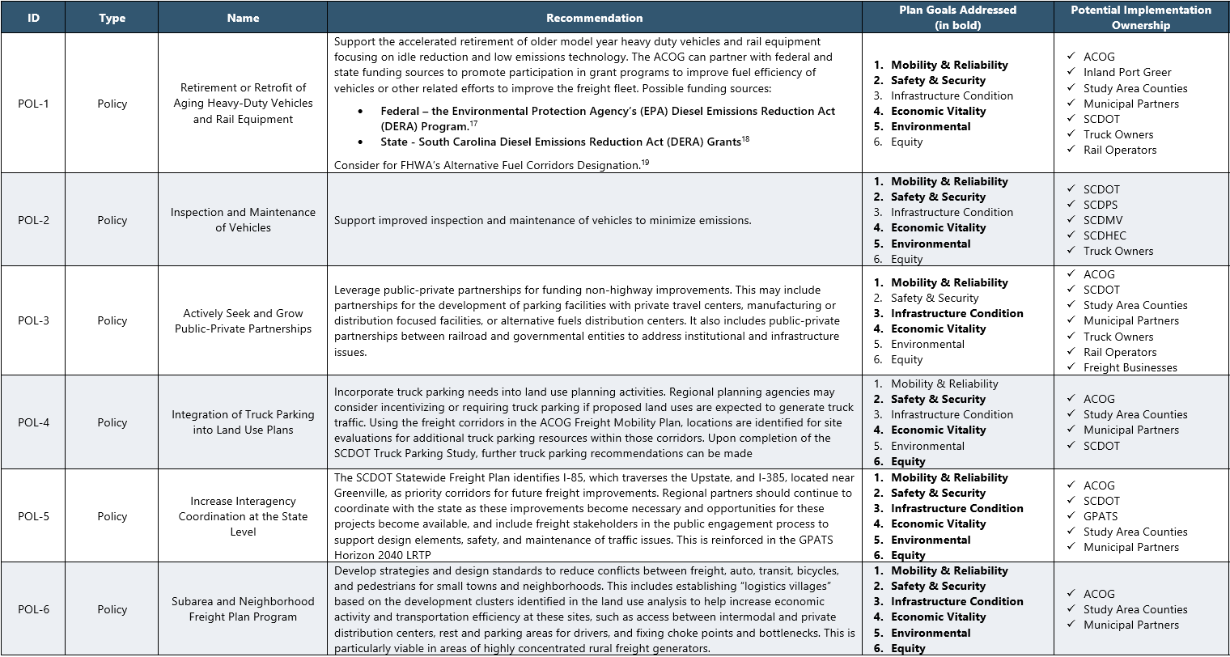
Notes:
Overview of how to read this table – these are NOT ranked but they DO include a subjective assessment of which Plan Goals are/can be addressed with these recommendations.
Critically important is the final column on the right – listing of POTENTIAL implementation partners.

Slide 31
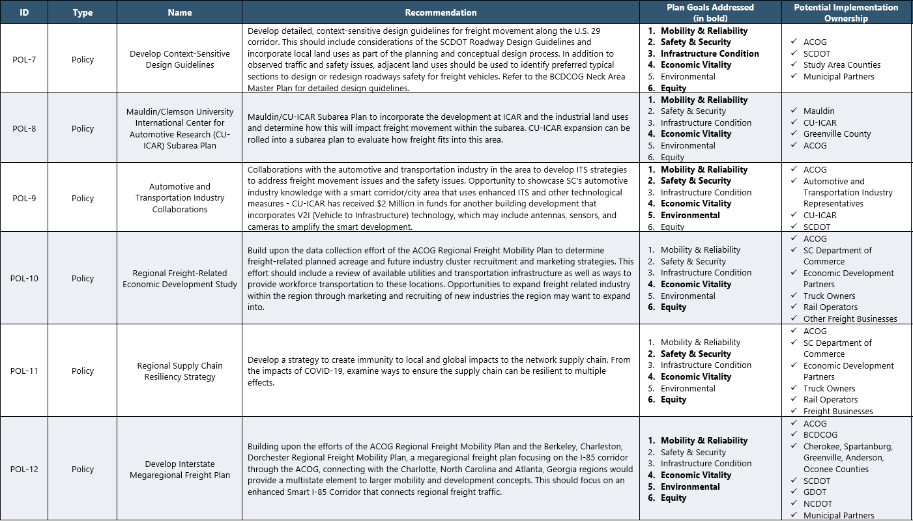

Slide 32
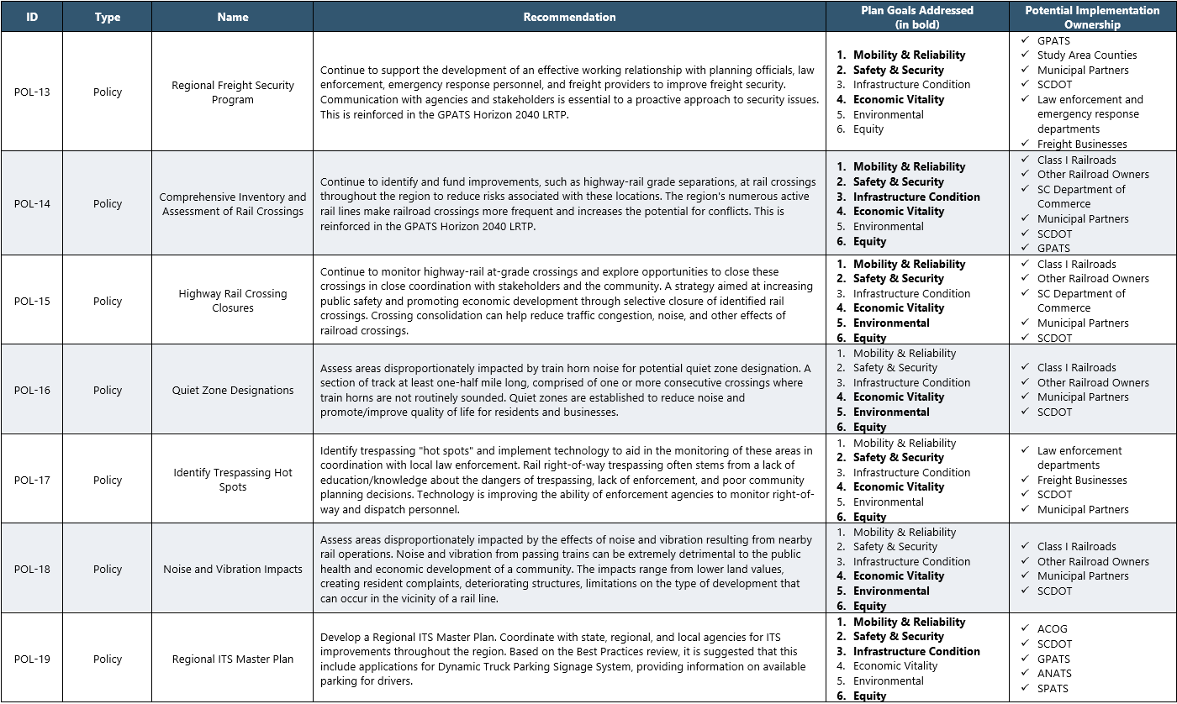

Slide 33
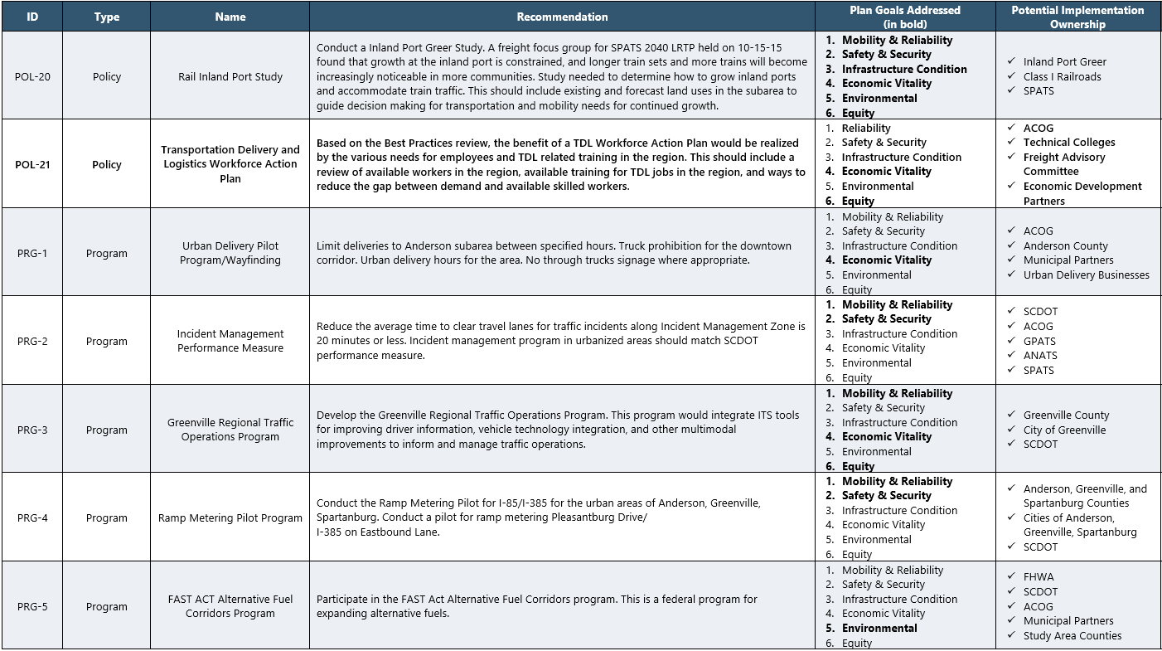

Slide 34
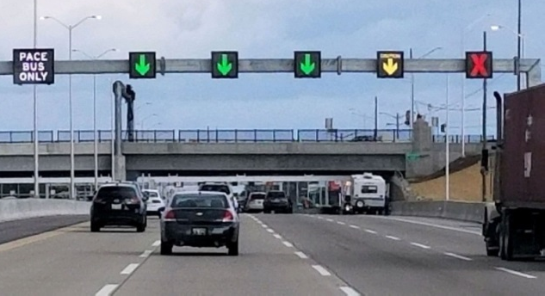
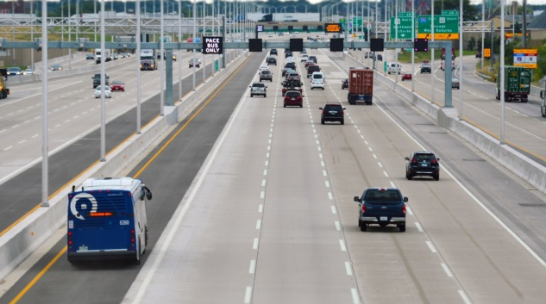
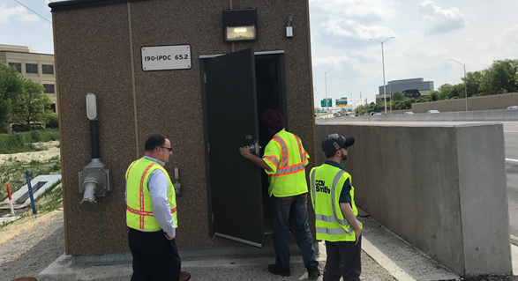
Smart Corridor Planning
A comprehensive approach to integrating existing transportation infrastructure with physical, operational, and technological improvements to provide users accurate, real-time information and to actively manage traffic.
Photos: Illinois Tollway

Slide 35
Smart Corridor Components
Physical improvements
Extend ramp lengths, add emergency pull-offs, install ramp meters, maintain roadsides, pavement markings, signage
Operational improvements
Managed or dedicated lanes, congestion pricing, traffic signal coordination, transit signal priority, safety patrols
Technology improvements
Dynamic messaging signs, closed-circuit television, roadside sensing equipment, real-time data sharing, data storage

Slide 36
Appalachian Region Smart Corridor
Create a Smart Corridor Coalition with the purpose of:
Facilitating regional public/private/institutional partnerships and collaboration
Creating a roadmap for advancing strategies across the region
Communicating the vision, goals and objectives to stakeholders and the public
Identify gaps and industry user needs
Assessing the current infrastructure and readiness of the system
Identifying candidate corridors throughout the region
Building a coalition for the pursuit of public-private partnership funding opportunities
Clearing the path for implementation

Slide 37
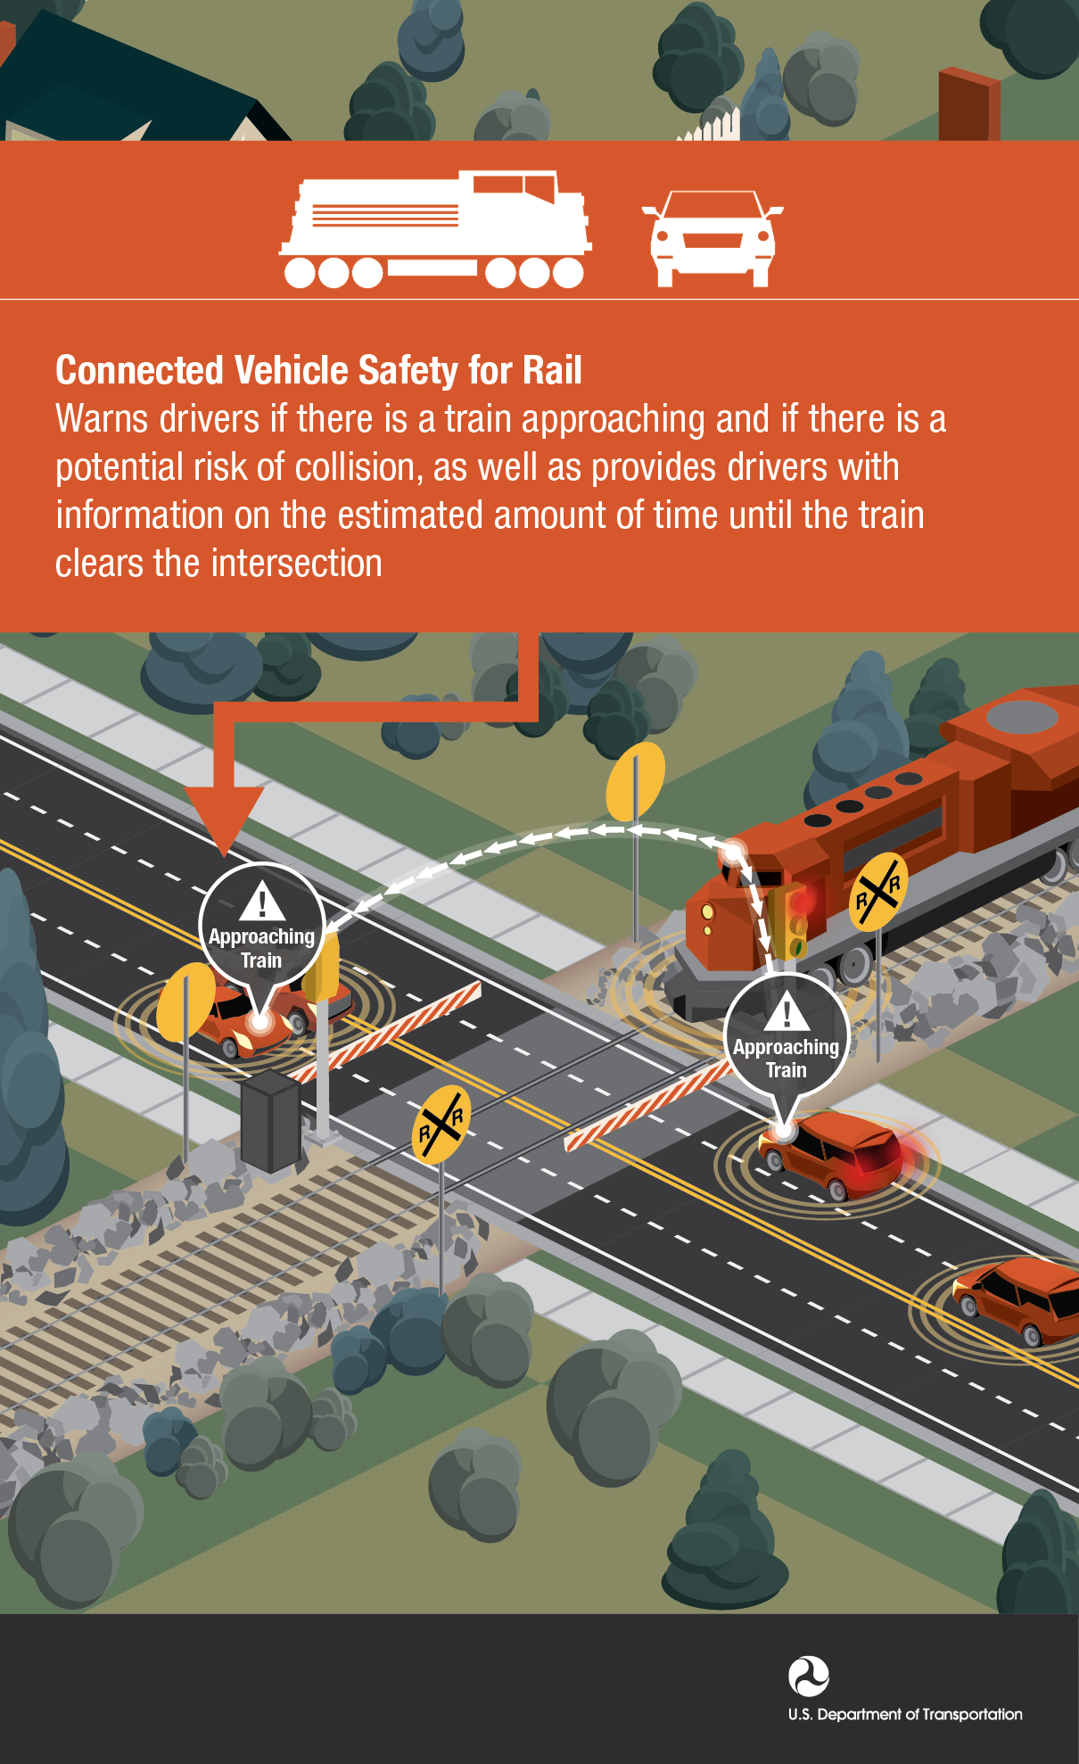
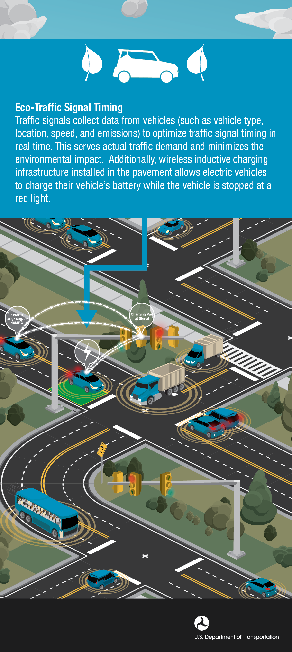
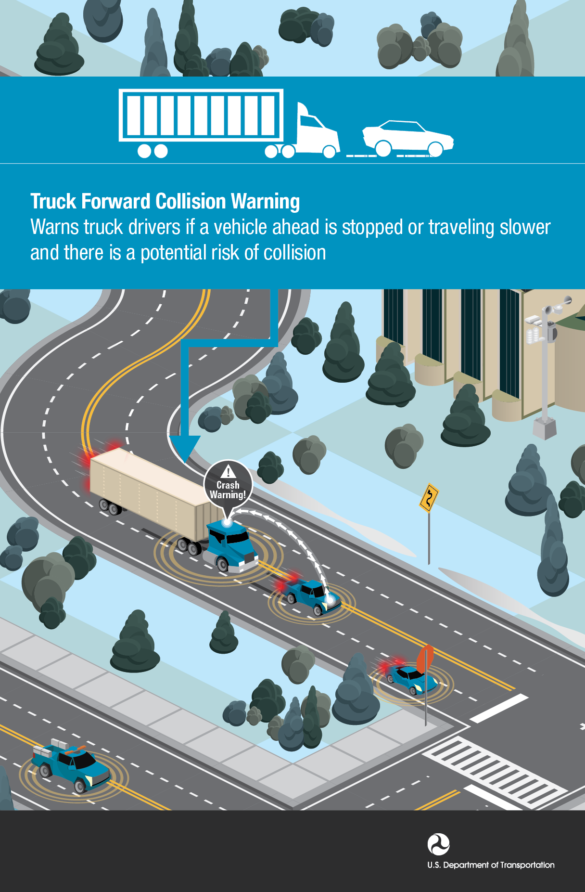
Emerging Technologies & ITS Strategies
Connected and automated vehicles
Collision warning systems
Traffic signal prioritization (transit, freight)
Graphics: USDOT

Slide 38
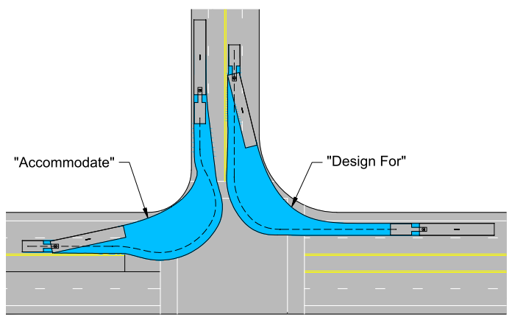
Freight Design Criteria
Freight design criteria are guidelines that are made to ensure the movement of freight across urban, suburban and rural areas
Typically involves construction improvements to accommodate freight in multi-modal corridors
Adopt standards for lane width, speed limits, marked facilities for bikes & pedestrians, ITS facilities, etc.
Source: City of Seattle
Local Municipalities

Slide 39
Implementation of the Freight Plan

Slide 40
How to Use The Freight Plan
State and Federal Agency Partners
Metropolitan Transportation Planners
Councils of Governments and Municipal Planners
Private Sector Interests
Notes:
You’ll find the final chapter of the freight plan outlines the roles each of these partners can play in the implementation of this plan and items recommendations.
This plan absolutely will not “sit on the shelf” and it is already in motion in many ways.
I mentioned earlier that this plan will need to adapt to changing conditions and we hope that as we continue to grow as a region that this plan provides the basis for freight policy and infrastructure investments in the region.
In terms of our state and federal partners, we hope that this plan will assist SCDOT with local freight needs and issues for inclusion in the overall state freight program, and through continued coordination we hope that SCDOT will inform us statewide freight issues and needs that may impact the Appalachian Region. One project that SCDOT is currently working on is a Statewide Truck Parking Assessment, which directly relates to some of the issues we have identified as part of this plan, specifically along the interstate system in the Upstate. David Gray from SCDOT is the PM for that project and he is on the call this morning. David, would you be willing just to give us a summary of that SCDOT planning effort?
We will also coordinate with our federal partners as a National Freight Strategic Plan is developed and make sure that regional priorities are included in that planning effort.
From an MPO perspective, one of the deliverables of this plan is an MPO-specfic freight planning document that MPOs can use to include in their LRTP updates. The MPOs will review the project recommendations within their planning areas and incorporate them into their ranking process for programming and implementation.
We really hope that those of you working at the county and municipal level will help by considering the land use and policy recommendations as you make decisions regarding freight land use. Prioritizing developing sites located in existing freight corridors and concentrations that are closest to major freight generators is crucial in preserving the most strategic areas of land for freight-related growth. Incorporating truck parking requirements for developments that rely on truck traffic such as rest areas and truck stops are critical to combat the region’s truck parking shortage. Really at the end of the day it comes down to being intentional about land use and transportation connections in these areas.
Lastly, our private sector partners will help us by leveraging public-private partnerships for funding non-highway improvements and developing collaborations between industries. Building on the foundation of the regional freight plan, the continuation of FAC meetings is important to sustaining the discussion of freight with regional partners.

Slide 41
Funding Options
Rebuilding American Infrastructure with Sustainability and Equity (RAISE) Grant Program
Infrastructure for Rebuilding America (INFRA) Grant Program
Railroad Rehabilitation & Improvement Financing (RRIF) Loan Program
Transportation Infrastructure Finance and Innovation Act (TIFIA) Grant Program
Local Planning Partners (Counties, Municipalities)
Notes:
This is a list of funding sources – above and beyond our traditional funding processes. We’ll clearly use this plan to update our local Long Range Transportation Plans (LRTPs) as those get updated, but this ever-changing list of federal funding opportunities will remain on the radar for our planning team.

Slide 42
Next Steps
Public review and comment on the DRAFT Regional Freight Mobility Plan and supporting materials
Presentation to Appalachian Council of Governments
GPATS Study Team and Policy Committee
SPATS Study Team and Policy Committee
ANATS Study Team and Policy Committee
Address comments and finalize plan documents
Ongoing activities for these Committees
Notes:
We’ve got a formal process to follow – starting with presentations to our regional study teams and policy committees
We have documents out for public review and comment – and those comments will be addressed in a “FINAL” plan document
And then the ongoing work of this group – our critical committee members to support these various projects, policies and programs as they begin to take shape

Slide 43
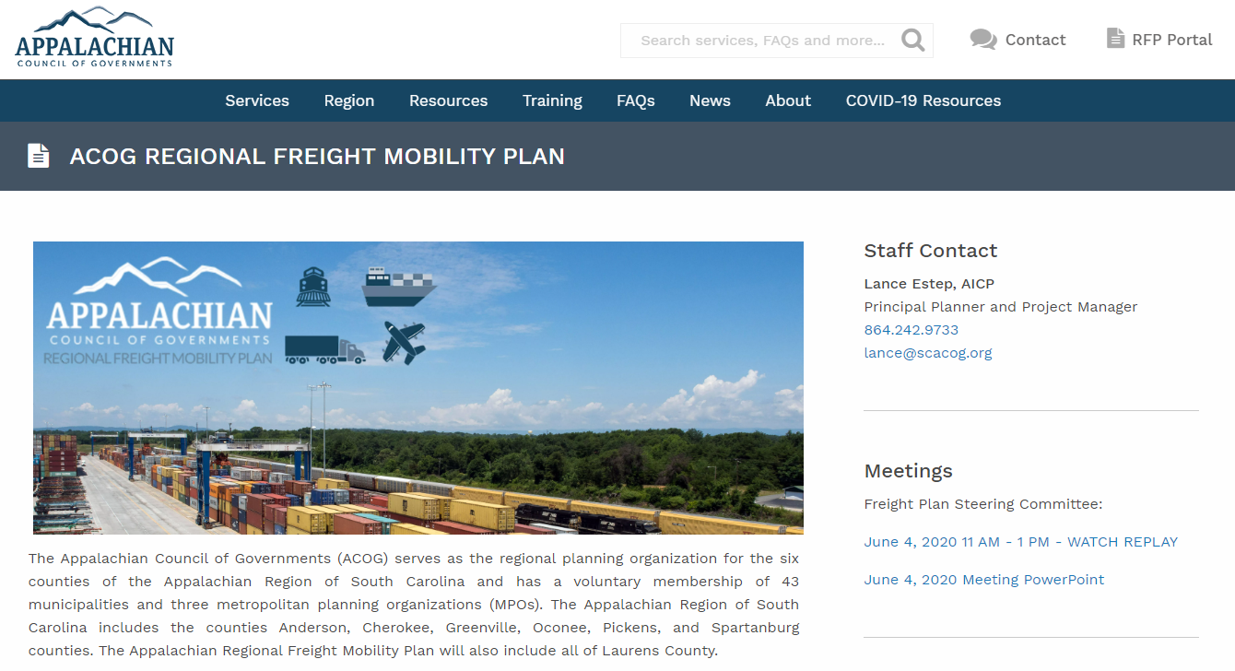
Thank You
Stay Connected!
SCACOG.org/acog-freight-plan
Lance Estep, AICP Appalachian Council of Governments
Project Manager
Greenville, SC
lance@scacog.org
@AppalachianCouncilofGovernments
@SCACOG

