Slide 2
Appalachian Regional Freight Mobility Plan
Freight Advisory Committee Meeting #1
July 30, 2020
Notes:
AMY TO OPEN THE MEETING WITH DISCUSSION OF PROTOCOL

Slide 3
AGENDA
1
Meet the Team
2
Introduction to Freight Planning
3
What is in Store for
Our Region?
4
What can You Expect Next?
Notes:
AMY TO GIVE AGENDA OVERVIEW

Slide 4
Introduction to Speakers
Lance Estep, AICP Appalachian Council of Governments
Project Manager
Greenville, SC
Jenny Humphreys, AICP CDM Smith Consulting Team
Project Manager
Charleston, SC
Notes:
AMY TO GIVE BRIEF INTRODUCTION
LANCE:
Senior Transportation Planner with App. Council of Governments
Participates in many comprehensive plans in the region – very well versed in both land use and transportation planning in the region
Will be the SINGLE POINT OF CONTACT for project related information for the Freight Advisory Committee
JENNY
Senior Transportation Planning with CDM Smith
Based in Charleston, SC
Previously managed SCDOT Statewide Freight Plan, Columbia and Charlotte Freight Mobility Plans
Leading this team of planners, economists and engineers to deliver this for the Appalachian Region!

Slide 5
Meet the Team
Notes:
AMY TO TRANSITION TO LANCE TO INTRODUCE THE TEAM

Slide 6
Project Sponsors
Lance
Estep
Keith
Brockington
Lisa
Bollinger
Mike
Gay
Notes:
LANCE’S SLIDE:
Introduction to who ACOG and any additional background on this plan:
​
Why are we doing this plan?​
Where this will fold into the larger plans for the region​
Significance of this group doing a plan together for the first time
Other thoughts
ACOG – Lance Estep
In partnership with (photos, if available)
GPATS – Keith Brockington
SPATS – Lisa Bollinger
ANATS – Mike Gay

Slide 7
Agency Partnerships
Notes:
JENNY – ​
​
This plan will not be developed in a vacuum – we’ll work closely with our partners at FHWA and SCDOT. ​
​
They’ll partner with us in data sharing, incorporating local plans into larger statewide and regional plans – as well as in the eventual implementation of this plan. ​
​
DIANNE LACKEY WILL BE ON THE LINE – DIANNE, WOULD YOU LIKE TO ADD ANY THOUGHTS FOR THE GROUP ON BEHALF OF SCDOT?

Slide 8
Consultant Team
Notes:
JENNY TO INTRODUCE THE CONSULTANT TEAM​
​
Brief introduction to our consulting team:​
​
CDM Smith – background in freight planning​
​
​
TRANSYSTEMS – Will be supporting the team with intermodal movement planning, rail intermodal​
​
MODERN MOBILITY – DBE partner out of Atlanta – will support the team in the areas of technology in freight mobility and project prioritization​
NOTES ON TRANSPORTATION EQUITY –
Historically, transportation projects and transportation plans focus on capacity and mobility.
In developing freight plans, we view your regional transportation system as a critical piece of your region’s economy – thus – providing access to jobs, education, and other economic opportunities.
This plan will include both urban and rural considerations for opportunity and mobility as well as planning for safety and potential impacts of freight movements on our communities and physical environment.
We want you to know that we – and our partners – aren’t just looking about trucks trains and planes – but very much the people and communities.

Slide 9
Roll Call of Freight Advisory Committee
Who is on the Call?
Notes:
Lance to ask the meeting attendees to introduce themselves and the organization they represent.
At the end of this slide – let’s add a polling question about who might be MISSING from this roster? Are there any additional participants this group might like to invite?

Slide 10
Roll Call of Freight Advisory Committee
Your name, organization, and role
What chapter will you turn to first in a new freight plan? What are you most interested in?
This is a publicly funded freight plan, what do you hope will come out of this?
Notes:
Lance to ask the meeting attendees to introduce themselves and the organization they represent.
At the end of this slide – let’s add a polling question about who might be MISSING from this roster? Are there any additional participants this group might like to invite?

Slide 11
Regional Freight Advisory Committee
Your Role on the Project
Learn
Provide Feedback
Connect with Colleagues
to Raise Awareness
Maintain Momentum
Support the Implementation
Notes:
JENNY –​
​
In case you’ve wondered what you’re doing here or on this invitation list, here are some thoughts on what we hope your role will be as we kick off, develop, and implement this plan. ​
​
First – LEARN. We’ve developed an engagement program through which we’ll share will you a great deal about freight planning and freight systems. We’ll also work extensively to make sure this working group understands the needs for, costs of, and prioritization of transportation infrastructure to support your businesses and industry as a whole. ​
​
Second – We’d love to get your feedback. Over the next several months, we’ll present to you draft work products and will conduct a series of surveys or other data gathering activities. Our plan is only as good as the information we can receive – and we need your review and feedback throughout this process​
​
Connections – Not only do we hope you’ll collaborate with this group that has gathered today, but we hope you’ll seek opportunities to share information beyond this group. When information becomes available and input needed, we hope you’ll engage your network of colleagues to gather additional insight and perspective on these topics. ​
​
Maintaining Momentum is another critical role for this group. When the consultant team is working hard behind the scenes, it will be important for us and ACOG to get your support in maintaining the momentum as we get closer to the final draft of the plan and implementation phases of this work. We’re working on a fairly aggressive schedule, so we do not anticipate this being a major concern, but we do hope you’ll do your best to stay engaged and participate in as many meetings as possible. ​
​
Finally – we hope you’ll champion the implementation of this plan. Typically, professional planners and engineers are not I a position to advocate for projects or policies that are created in the development of a plan. We’re here to provide plan stakeholders – you all – with the data and information needed for you all to champion and/or advocate for what you feel needs your support in the larger community. Hopefully your job here won’t end when the plan is completed – perhaps that is when you’ll really get working!​

Slide 12
Introduction to Freight Planning
Notes:
JENNY TO INTRO THE PURPOSE OF THIS SUBJECT MATTER

Slide 13
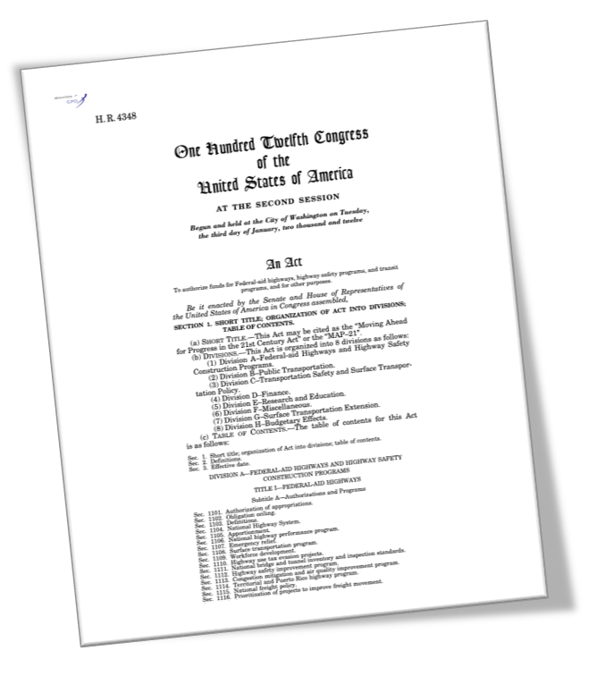
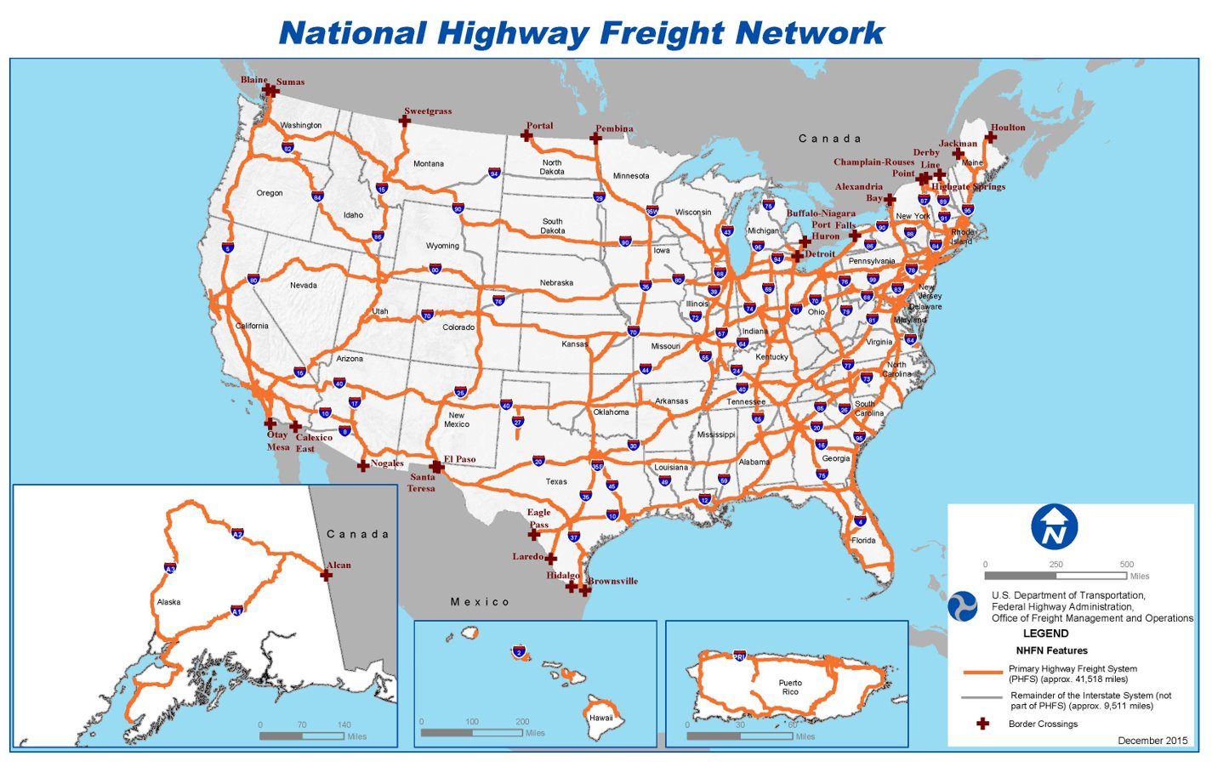
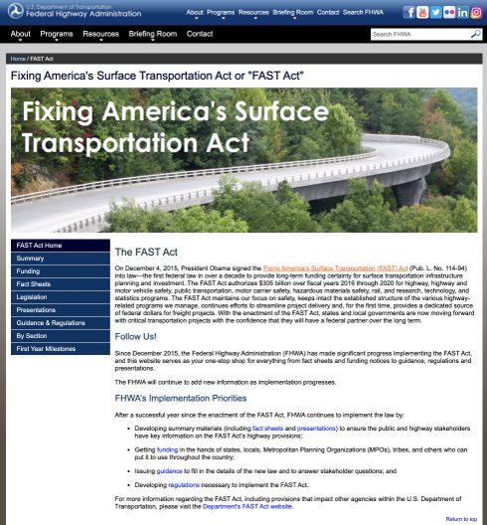
Freight Planning in the United States
Notes:
This map shows the Primary Highway Freight System (PHFS) plus remaining Interstates not on the PHFS, approximately 51,029 of roads. These routes are identified as the most critical highway portions of the U.S. freight system and that is informed by measurable and objective national data. The map also illustrates key land ports of entry in the U.S. based on an inventory of national freight volumes conducted by the Federal Highway Administration during the designation process for the MAP-21 highway-only primary freight network (PFN) under 23 U.S.C. 167(d).
USDOT provides guidance in the arena of freight planning. Dating back several decades, we've had federal legislation related to freight mobility planning. This has largely been focused around safety and congestion. ​
​
Under the MAP-21 package in 2012 and the current guidance under the FAST-Act signed in 2015, freight mobility and related performance measures has become a more prominent topic in transportation planning. It also attached funding to projects that support the performance of our national freight network and funds that support projects that demonstrate improved safety, efficiency of our nation's freight infrastructure. ​
​
This latest guidance not only increases the goals of freight planning to include the economic impact of freight but also the overall resiliency of the freight transportation networks our nation depends on for international trade. ​
​
Illustrated here is some information related to federal freight plans, including a map of the latest version of the National Highway Freight Network. ​
​
Think of national planning as macro level – big picture that is of NATIONAL SIGNIFICANCE – and then we get closer and closer to home... ​

Slide 14
Freight Planning
FHWA, Megaregions
Notes:
One topic that has emerged in the arena of freight planning at the federal level is the concept of "megaregional" planning. ​
​
The philosophy behind this is very much common sense – that is the concept that the movement of freight and the access to jobs happens [large]y without regard for state or other political boundaries. In megaregional planning, we are challenged to look beyond traditional planning boundaries to understand the patterns of goods movement and the movement of people to access jobs related to freight. ​
​
I'd like to draw your attention to where we are located on this map – the Piedmont region.

Slide 15
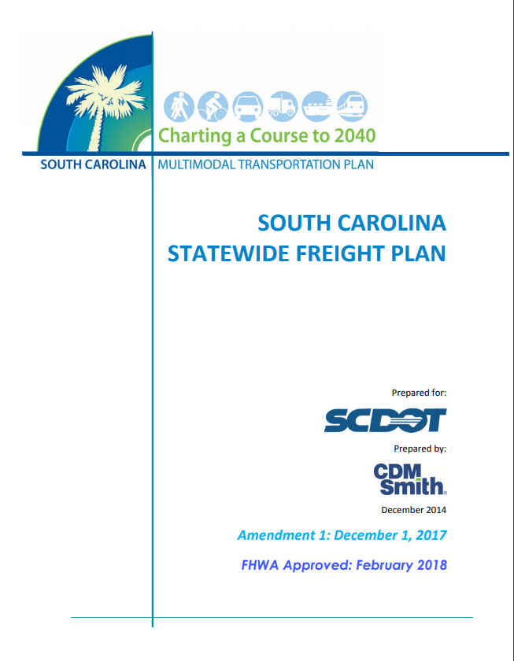
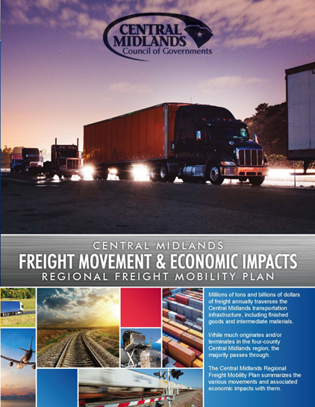
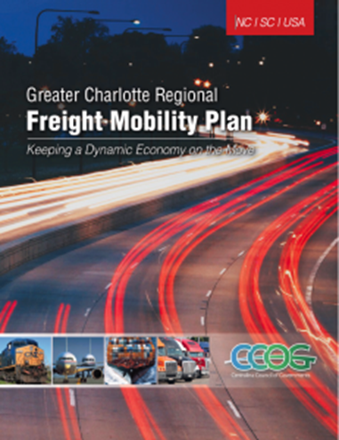
Freight Planning in South Carolina
South Carolina Statewide Freight Plan
Central Midlands Regional Freight Mobility Plan
Greater Charlotte Regional Freight Mobility Plan
Notes:
THIS IS A SAMPLE OF OTHER FREIGHT PLANS AVAILABLE IN OUR AREA –
While this will be a ‘unique’ or ‘original’ planning effort for the Appalachian region, we will be certain to consider the contents of these plans to see where we have some common goals, data sets, and complementary performance measures.
In a plan like this – we try to collaborate with regional partners to see where their recommendations can ‘feed’ ours, and vice versa.

Slide 16
What is in Store for Our Region?
Notes:
JENNY – MOVING INTO OUR SCOPE OF WORK AND WHAT THIS PLANNING EFFORT WILL LOOK LIKE.

Slide 17
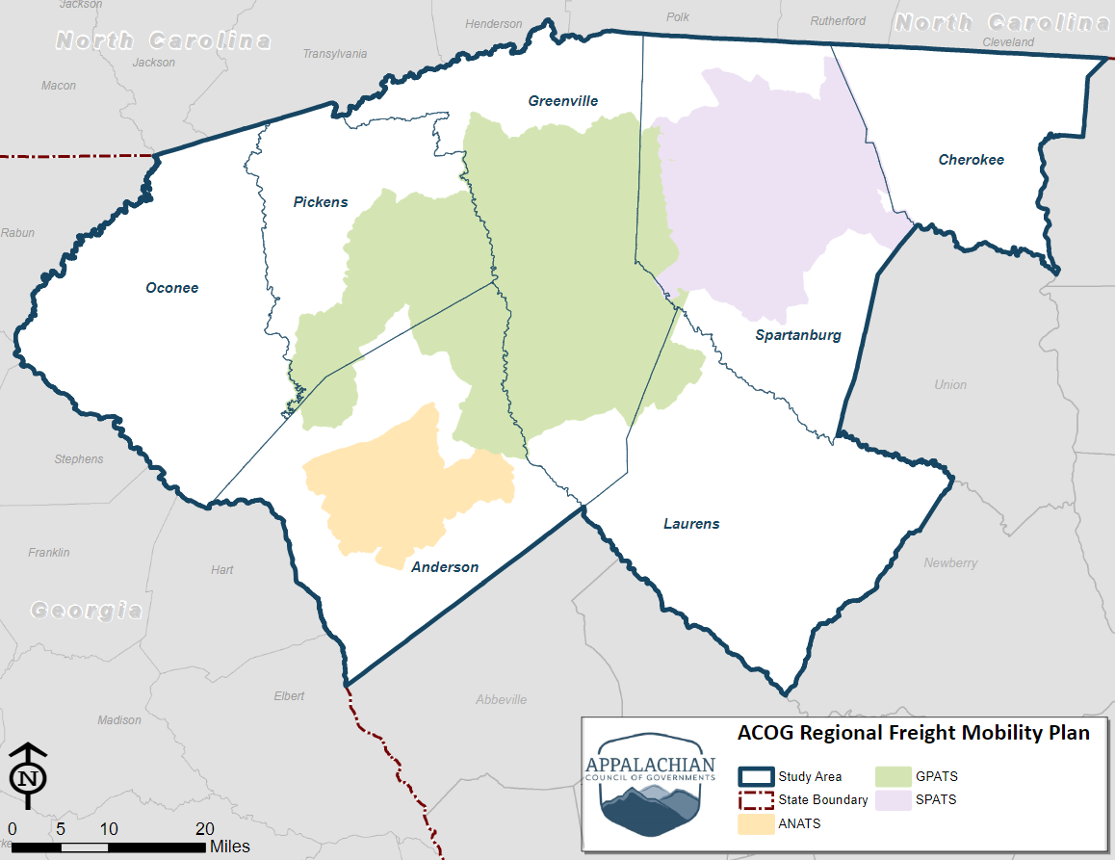
Freight Plan Work Products
Appalachian Regional Freight Mobility Plan Study Area
Notes:
Our study area, 6 counties of ACOG and Laurens County
Why did we add Laurens County? The Greenville MPO carries over into Laurens

Slide 18
Freight Plan Work Products
Projects:
Roadway & Rail Capacity
Bridges
Intermodal Connectors
Truck Parking
Traffic Operations
Policies:
Roadway Design Guidelines
Educational Partnerships
Land Use Recommendations
Economic Development
Funding Programs
Notes:
Projects
Policies
Other spin offs:
Relationships
Regional collaboration
Grant programs
Public/Private partnerships
Private investments

Slide 19
Freight Plan Work Products
Other Spin-off Work Products
Relationships
Regional Collaboration
Grant Programs
Public/ Private Partnerships
Private Investments
Notes:
Other spin offs:
While these items don’t appear in a plan document, per se, but we have seen this process play out with a series of additional benefits in the study area.
Relationships
Regional collaboration
Grant programs
Public/Private partnerships
Private investments

Slide 20
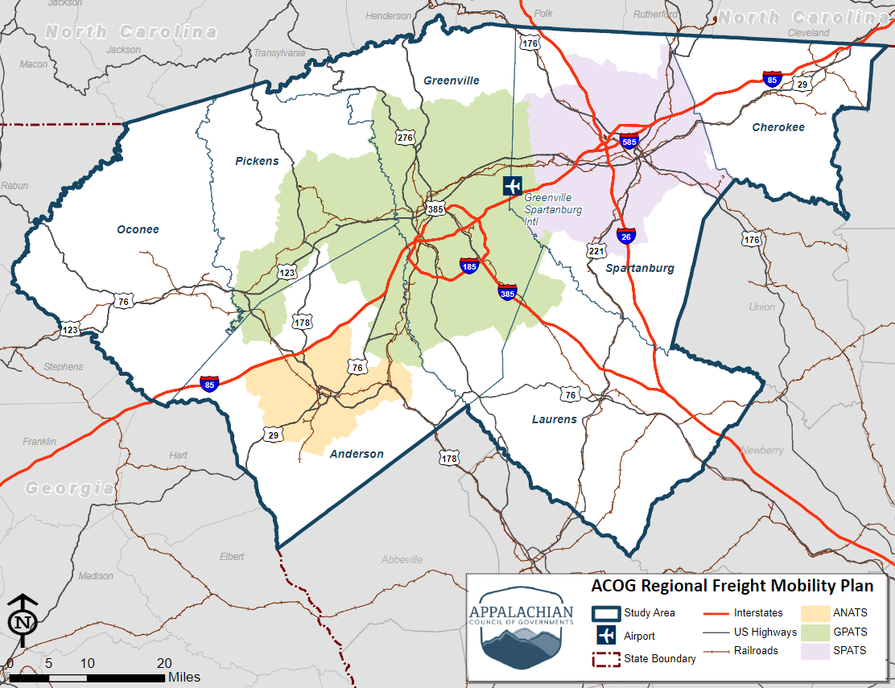
Appalachian Regional Freight Planning
Planning for multiple modes of freight transport (highway, rail, air)
Establishing a strategic freight network
Evaluating the condition of that network
Notes:
JENNY – GETTING A LITTLE MORE INTO THE SCOPE OF WORK:
THIS IS A MULTIMODAL PLAN – Highway, rail, air cargo
DEVELOPMENT OF A STRATEGIC FREIGHT NETWORK –
We start with a comprehensive approach/perspective on the regional transportation system
Based on observed data (traffic counts, etc), we develop a draft ‘strategic’ freight network for this group to review
Based on that review and feedback, we’ll refine that network and progress the needs analysis

Slide 21
Appalachian Regional Freight Planning
Forecasting our Needs
Safety
Capacity/ Infrastructure Needs
Technology
Financial
Notes:
JENNY –
WHAT DOES THAT NEEDS ANALYSIS LOOK LIKE? Similar to what you’ve possibly seen before, but remember that this is across all modes included –
SAFETY – What are the existing data telling us? What are the causes of those safety issues?
CAPACITY – Pretty straight forward – how are those roadways, rails, etc expected to hold up to demand for capacity to move freight into the forecast years?
TECHNOLOGY – We have plenty of lessons learned across the industry where technology can play a significant role in the movement of freight and system performance
FINANCIAL – What is our expected financial need to support that system? We’ll take a look at a desired level of service for the strategic network and will estimate what we believe the cost of meeting that LOS into the forecast years.

Slide 22
Appalachian Regional Freight Planning
Understanding that Freight is the Economy in Motion
Freight volumes
Volume
Mode
Direction
Commodity
Economic impacts associated with freight transportation
Employment
Income & Output
Clearly presented analyses
Notes:
JENNY – OVER OF ECONOMIC STUDIES
Freight – reflects the production, consumption, and trade of physical goods
Freight volume – comprises the tons, value, units moved by mode, direction, and commodity
Based on TRANSEARCH and other data sources
Economic impacts – quantifies the employment, income, and output associated with transport providers and users (shippers/receivers)
Freight volumes by commodity and direction used in conjunction with IMPLAN economic model
Freight volumes
Volume – tons, value, units (trucks, railcars)
Mode – truck, rail, air, water
Direction – inbound, outbound, internal, through
Commodity – 40 broad categories (750+ sub-groups)
Economic impacts
Activities – Freight transport (trucking, RR) and users (shippers/receivers)
Types – direct impacts, indirect suppliers, induced respending
Measures – employment, income, output, etc.

Slide 23
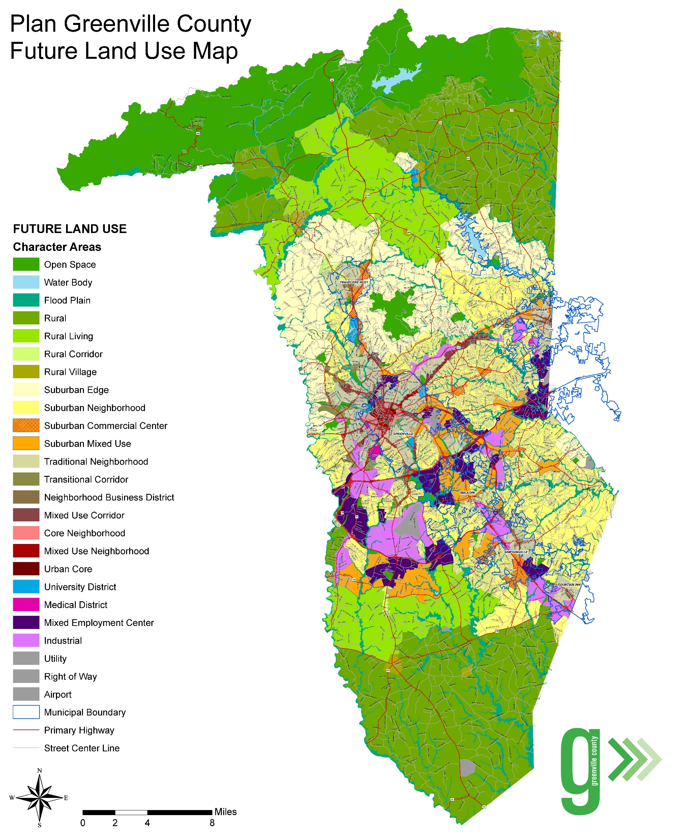
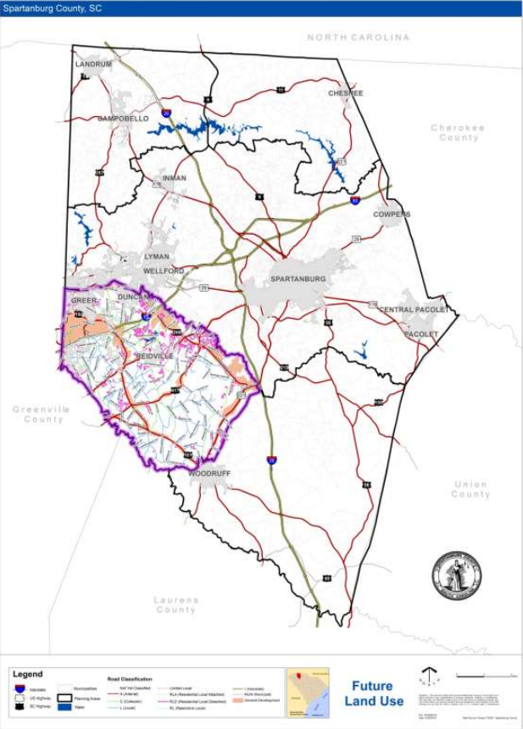
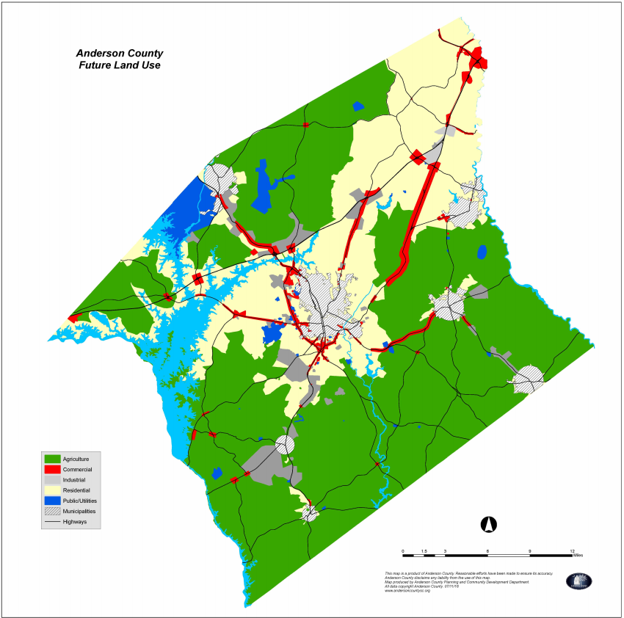
Appalachian Regional Freight Planning
Land Use Integration
Anderson County Comprehensive Plan, Future Land Use, 2016
Greenville County Comprehensive Plan, Future Land Use, 2019
Spartanburg County Comprehensive Plan, Future Land Use, 2018
Notes:
Land Use Integration – integrating future land use plans
This will NOT be a new comprehensive plan for the region, but rather a tool to complement regional land use planning.
Those in economic development know that developers visit the region and have a ‘wish list’ of transportation assets to support their industry.
This analysis will be a very interesting iterative analysis of overlaying existing infrastructure with land use plans (existing and forecast) and see where we are aligned or misaligned in terms of providing freight infrastructure to support the development.
Similarly, we can work with this plan to help the economic development community identify where/where not to improve transportation infrastructure to support freight mobility.
*Want to avoid conflicts in land use and transportation needs. Safety and over/under investment analysis

Slide 24
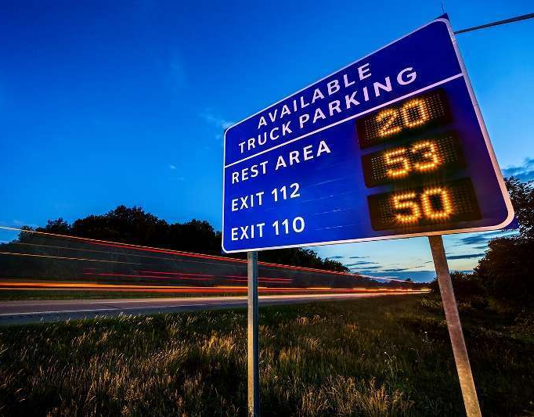
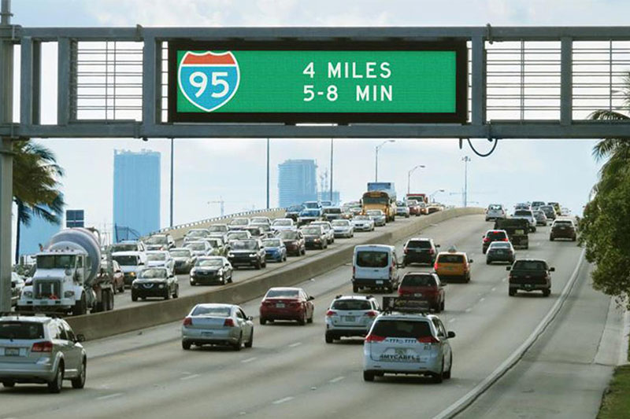
Appalachian Regional Freight Planning
Transportation Technology
Truck Parking Signs
ITS/Dynamic Message Signs
Truck Platooning
Notes:
JENNY –
I’m sure we’ve all heard the phrase “we can’t build our way out of congestion”
I think we all agree with that. We also know, from many decades of supporting freight mobility, that there are many advances in transportation technology that are focused on supporting the safe and efficient movement of freight vehicles of all types.
Some apply to ALL users of the right of way – some are mode specific
Shown here are a few examples of the technology applications we plan to explore for our region – in terms of where these could meet the estimated needs as well as where these could be incorporated into a financial implementation plan.

Slide 25
Appalachian Regional Freight Planning
Financial Planning and Plan Implementation
Cost Estimates
Grant Funding Opportunities
Local and State Plan Integration
Notes:
Financial Planning and Implementation
Cost estimates – planning level cost estimates to prepare the plan as well as prepare applications for potential grant programs
Grant funding opportunities – many federal funding programs focused on the movement of freight, across all modes of transportation. This team includes economists and planners who specialize in identifying, applying for, and managing the use of those federal dollars. Throughout plan development, we’re keeping our eye out for those opportunities
Local and State Plan Integration – Eventually, the plan recommendations will be implemented into many OTHER local and state plans.
Not included here are ‘private’ implementation opportunities – most freight plans identify programs and projects that can be most appropriately implemented by a combination of public AND/OR private entities – and possibly non-profit or academic partners as well.

Slide 26
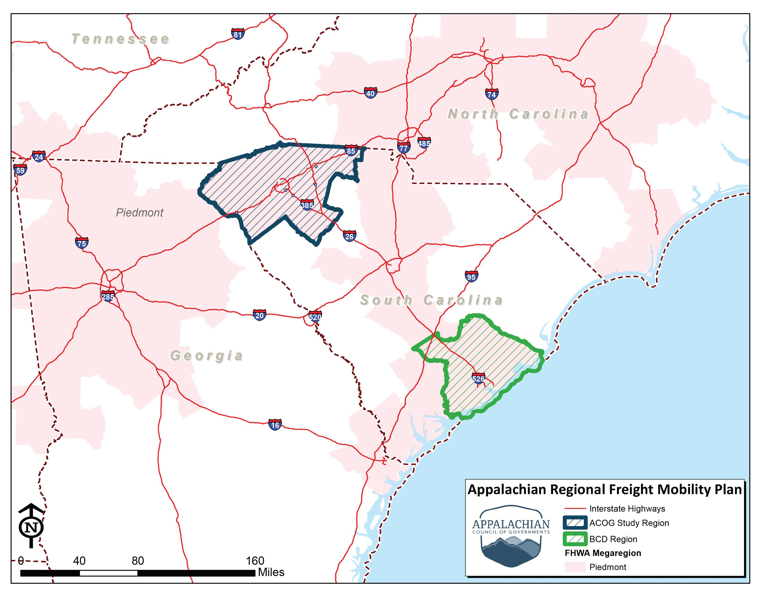
Appalachian Regional Freight Planning
Notes:
We already talked about megaregional planning (FHWA), this map shows your regional freight plan and Charleston’s regional freight plan
Simultaneous planning efforts
Common project consultant team – streamlined analyses and data opportunities
Potential for overlapping plan stakeholders
We’ve discussed several times that freight does not recognize boundaries – and we know there are planning implications at both ends of the I-26 corridor within many of our critical supply chains. Also discussed, we’ll have recommendations in projects AND policies, and having multiagency collaboration could be invaluable in the implementation of some of those.
We’ve built in some collaboration touch points in the public engagement program that we’ll discuss further a little later in the presentation.

Slide 27
POLLING QUESTION:
Now that you know what this freight plan is, what are you most excited about?
Notes:
Now that you know what this freight plan is, what are you most excited about?
Fixing the condition and capacity of our highways
Improving safety for freight mobility
Understanding the economic impact of freight mobility
Integrating land use and transportation planning
Supporting regional & statewide partnerships
Identifying additional transportation funds
Learning how to support the implementation

Slide 28
Stop and Pause
Please “raise your hand” or type your questions in the questions box for open discussion
Notes:
JENNY – The last handful of slides are related to what this group can expect moving forward. Let’s take this time to talk through the materials presented – please raise your hand or type questions/comments in the chat box on the right.
AMY TO MODERATE Q&A

Slide 29
What can You Expect Next?

Slide 30
FAC Meeting Series
MEETING | FAC MEETING DATES | FAC MEETING TOPIC
1 | July 30 | Introduction to Freight Planning
2 | Quarter 3, 2020 | Economic Analysis and Truck Parking
3 | Quarter 4, 2020 | Performance Measures and Draft Recommendations
4 | Quarter 1, 2021 | Finalizing the Plan

Slide 31
Meeting and Webinar Series
STEERING COMMITTEE MEETING DATES | STEERING COMMITTEE MEETING TOPIC | LUNCH & LEARN WEBINAR TOPICS
June 4 | Introduction to Freight Planning | N/A
July 16 | Best Practices & Network Assessment | Smart Cities & Railroad Technology
August 13 | Land Use Analysis | Truck Parking & Automation
September 10 | Economic Impact Analysis | TBD
October 8 | Technology Recommendations & Performance Measures | TBD
November 12 | Draft Plan Recommendations | TBD
December/ January Final Plan
Notes:
Times will be the same for this group, staying longer for the “sandwich portion”
Describe program format (Option 2 for future L&Ls) and potential topics
Include partnership with Charleston
Tentative meeting dates

Slide 32
Communications About the Plan
Project Website
Social Media Posts
Freight Advisory Committee Meetings & Webinars
Publications
Steering Committee Meeting Presentations
Email
Notes:
Project website
Social media posts – no plan specific handle
Freight Advisory Committee meetings and Webinars
Publications
Presentations
Email – As mentioned earlier, please consider Lance your single point of contact for emails. Please email him questions, comments, concerns, etc – and please be on the lookout for meeting invites or other project updates to come directly from him. We’ve got his info on a final slide

Slide 33
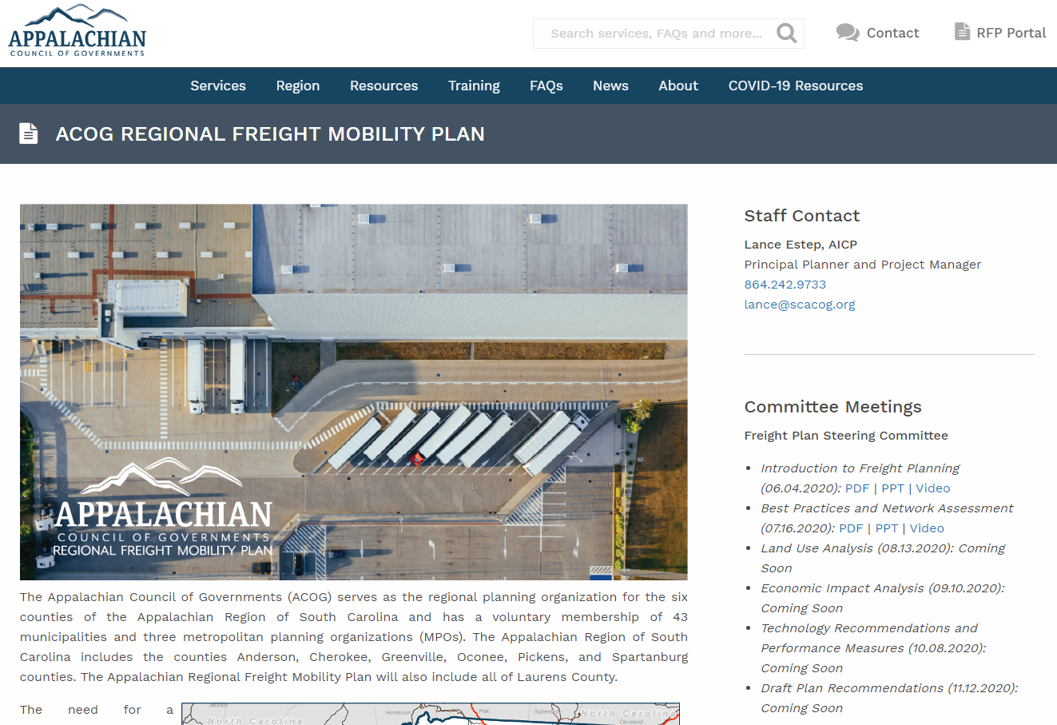
Plan Website and Social
www.scacog.org/acog-freight-plan
@AppalachianCouncilofGovernments
@SCACOG

Slide 34
Questions and Answers
Please type your questions in the questions box and our project team will answer them
If we do not get to all the questions, we’ll prepare written responses and post them to the website with the meeting recording

Slide 35
POLLING QUESTION
What other freight-related topics are of interest to you?
Notes:
THINK ABOUT HOW TO ASK “WHAT DID WE MISS” OR “WHAT TOPICS ARE OF INTEREST/CONCERN FOR YOU?”
You might have seen the planned “lunch and learn” webinars have some ”tentative” topics and some left as “TBD” – please let us know what we can bring to you.

Slide 36
POLLING QUESTION
How did this meeting format work for you?
Notes:
How did this meeting format work for you?
Good
Bad
Indifferent
THINK ABOUT HOW TO ASK “WHAT DID WE MISS” OR “WHAT TOPICS ARE OF INTEREST/CONCERN FOR YOU?”
Add Lance’s contact info here for follow up topics

Slide 37
Contact
Lance Estep, AICP Appalachian Council of Governments
Project Manager
Greenville, SC
lance@scacog.org
www.scacog.org

